Slide 1
Oulu International School Info Evening for New Applicants and Their Guardians
1. General info about Oulu International School (OIS)
2. Application process and language proficiency tests
3. Special features of OIS
4. Daily school life at OIS
Principal Jenni Alaniemi
Finnish Teacher Tanja Salo
TC Teacher Jenna Silveri
English Teacher Marja Peedo
School administrator Kati Tiikkainen

Slide 2
1. General info about
Oulu International School (OIS)

Slide 3
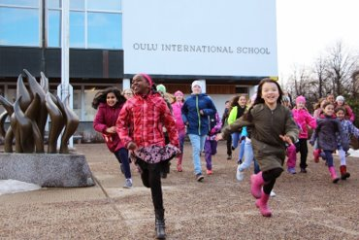
Our School
Public multicultural school ​
Grades 1-9
Finnish National Core Curriculum​
Language of tuition English​
CLIL school​; All teachers are language teachers
431 students from more than 42 countries with over 37 different languages
234 students with some other home language than Finnish
46 staff members
Transition Class and Individual Learning Path Group

Slide 4
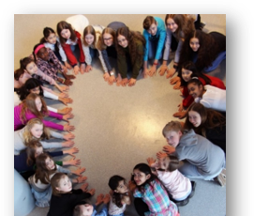
OIS Mission
”Joy of learning in a diverse and caring community”
OIS values​
Respect​
Responsibility​
Community​
Joy of Learning

Slide 5
2. Application process and language proficiency tests

Slide 6
How to apply and what are the language tests like?
https://www.ouka.fi/oulu/oulu-international-school/how-to-apply-to-ois

Slide 7
3. Special features of OIS

Slide 8
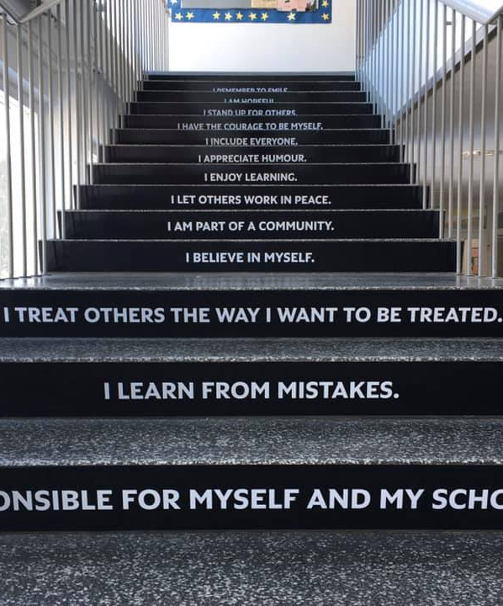
OIS Education
Holistic approach to learning and teaching
Emphasis on the following methods:
  Transdisciplinary learning
  Inquiry and phenomena-based learning
  Criteria based assessment and versatile assessment methods
Support for learning​
Student participation​ - Student seen as an active learner
Co-operation with guardians and other stakeholders

Slide 9

Language studies at OIS
Learn English as a mother tongue (3-4 lessons per week)
  Altogether 29 lessons during gr 1-9 per week compared to other schools in the Oulu area (18 during Gr 1-9).
  Learn all subjects mostly in English (CLIL).
Learn Finnish as a mother tongue (FMT) or as a second language (FSL) (3-7 lessons per week)
  Very little Finnish compared to English.
Learn Swedish from gr 6 to gr 9.
Optional A2 languages: Spanish, French, German offered.
→ OIS is for students who like learning languages and reading.

Slide 10
4. Daily life at OIS

Slide 11

School days
Between 8:15-16:00
  3-7 lessons per day depending on the grade level
  22-35 lessons per week depending on the grade level and amount of optional languages
  Some voluntary mother tongue lessons take place outside school hours
Students may not stay at school outside their class timetable.
Guardians are responsible for all expenses related to home-school transportation

Slide 12
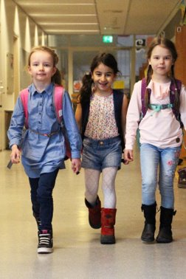
Afternoon care services
Available to 1st or 2nd grade students as well as for students who are entitled to special support.
Application period 1.1.2025-15.2.2025, in the Wilma system with a Wilma ID. The application form for afternoon activities is on the Applications and decisions tab. If you do not have a Wilma account, you can get a paper application form from Oulu10 services (Torikatu 10).
Groups are formed based on applications received during the application period. Therefore, remember to apply on time!
120 €/month (August-May) including insurance, activities and material costs, and snack.
More information https://www.ouka.fi/uutiset/koululaisten-iltapaivatoimintaan-haku-lukuvuodelle-2024-25-avoinna-152-saakka#:~:text=Voit%20hakea%20toimintapaikkaa%20lukuvuodelle%202024,PL%2017%2C%2090015%20Oulun%20kaupunki.

Slide 13
Open Afternoon care services in the City of Oulu
Children may spend afternoons at youth facilities in various parts of the city. The facilities are open for primary school children on weekdays, as a rule, from 12:00 to 17:00.
In general, the services are targeted for 7–17-year-olds (the age recommendation varies)
Children can play games, do homework and participate in guided activities supervised by trained adults. If the child wishes, they can bring their own packed lunch.
The services are the so-called open-house services, i.e., the parents and the child decide when the child enters and leaves the youth facility.
More information https://www.nuortenoulu.fi/vapaa-aika/nuorisotilat/ and https://www.ouka.fi/oulu/koulutus-ja-opiskelu/avoin-iltapaivatoiminta-nuorisotiloilla

Slide 14
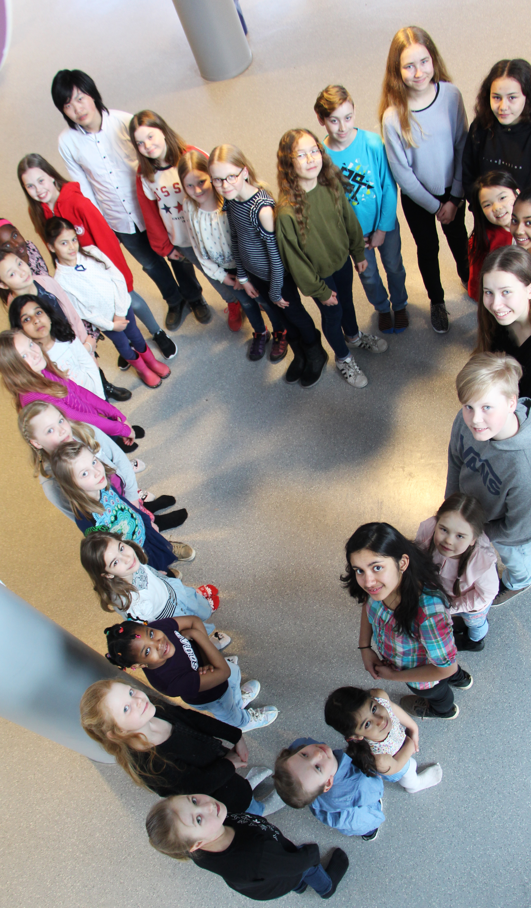
After School Clubs
After School Clubs are organized throughout the school year.
  The clubs are targeted mainly to grade 3-6 students
  The club info is sent in Wilma.
  Usually 1-2 clubs per week after school hours.

Slide 15

Matters to consider when applying to OIS
How will our family’s daily life look like in practice?
  How does my child commute to school and home?
  How much time does my child or I need to spend on commuting?
  How much time is left for homework, hobbies, friends and relaxing?
  How much time do I have to support my child with their daily reading and homework?
  What will my child’s network look like? Will their friends live close by or somewhere else?

Slide 16
Matters to consider when applying to OIS
What can I do to help my child in gaining more independence as a school child?
  Practice the journey to school and home first together then alone.
  Let my child do chores and tasks as independently as possible.
How will my child’s Finnish skills develop?
  What study options my child will have after gr 9 in Finland if their Finnish skills are not adequate enough for Finnish high schools or vocational schools?
How will my child’s mother tongue skills (incl. Finnish) develop?

Slide 17
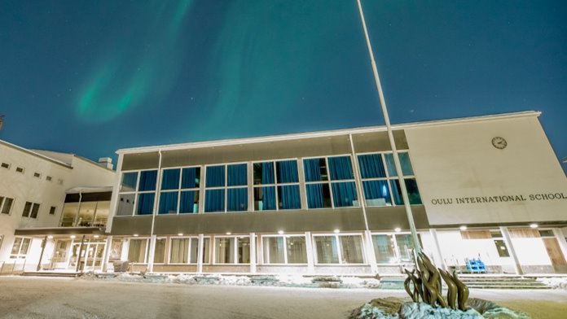
Thank you for your interest!

