Slide 1
The stories within us

Slide 2
Oulu Anti Racism week 2024
Today we will discuss diversity, listen to a story, and make a self-portrait.

Slide 3
Safer space guidelines
Interaction goes best in a non-discriminatory and safe atmosphere. Each of us can make a difference!
Respect and listen to others.
If a situation makes you feel uncomfortable, please tell the teacher
Feel free to ask and discuss.
Pay attention to your choice of words and use of humor.
Do not touch anyone without permission, and do not make comments about others' or your own body.
Stop or change your behavior if the other person asks you to.
Remember, that we are here to enjoy, learn, and communicate
Anything else to add?

Slide 4
What is diversity?

Slide 5
Story time

Slide 6
Now it’s time to hear from you!
How do you feel?
How would you like to be addressed?
How can we together build a space where you feel accepted?
How would you like to be talked to?
What things or people are the most important to you?
What do you do on the weekend?
Where places are nice to be in?

Slide 7
Exercise break

Slide 8
Time to create art
Within us live many stories, experiences, characters
They make us who we are.
Sharing them makes us grow together.
Let’s make some art!

Slide 9
How we are all connected?
Annetaan itsellemme aplodit rohkeudestamme ja avoimuudestamme.
Can you see yourself in your classmates works?
You can try to describe what you see using these phrases:
I want to understand… I feel the same… I want to know more about… This feels… It reminds me of…

Slide 10
Thank you for sharing your worlds!
Let’s give ourselves a round of applause for our bravery and openness.

Slide 11
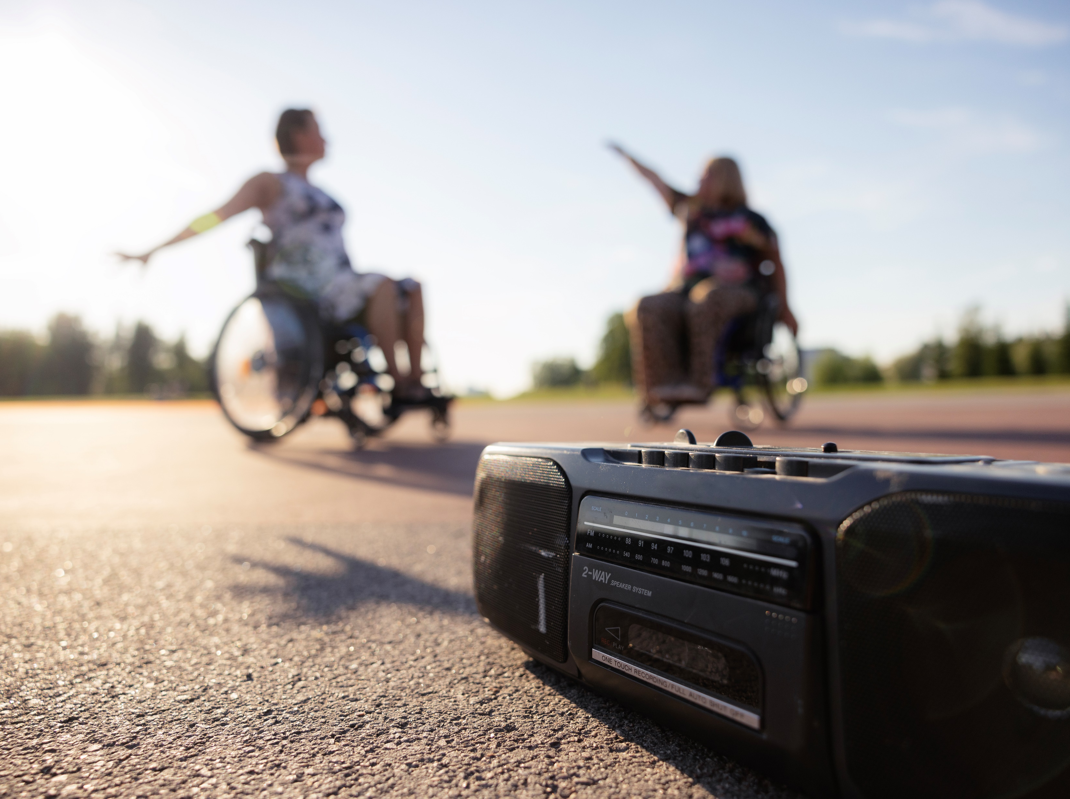

Thank you!
Workshop author:
Anastasia Artemeva
Slides changed to Oulu2026 visuals in the Equal Oulu2026 -project

