Slide 1
Intangible cultural heritage workshop
Workshop 1

Slide 2
Who are we?
Oulu2026
Northern Ostrobothnia Museum
Mobile Futures
Modify to fit your own workshop!

Slide 3
Who are you?
Where are you from?

Slide 4
What is living or intangible cultural heritage?

Slide 5

Celebrations

Slide 6
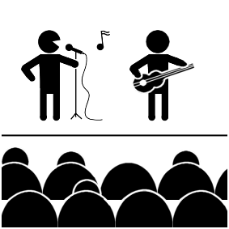
Music

Slide 7

Dance

Slide 8
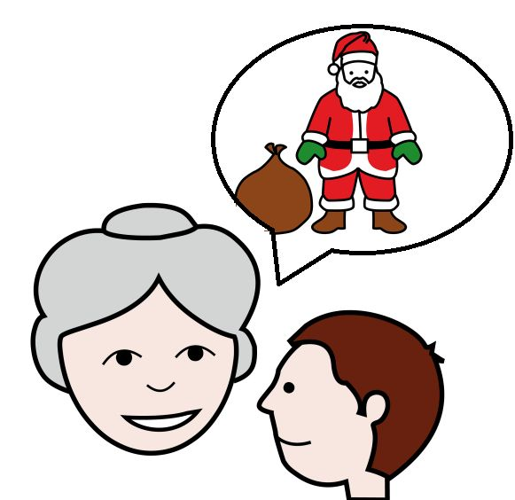
Stories

Slide 9
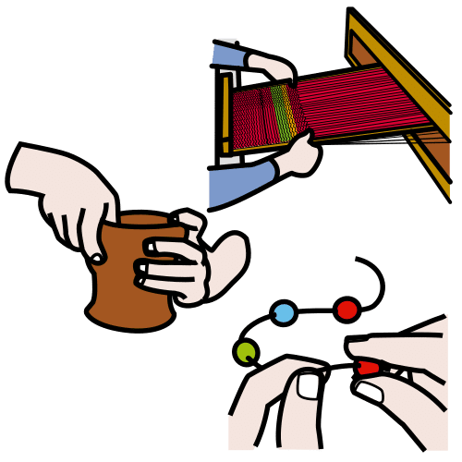
Handicrafts

Slide 10
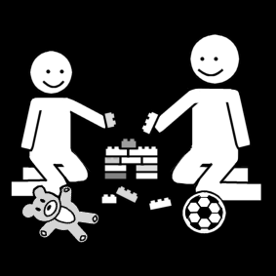
Games

Slide 11
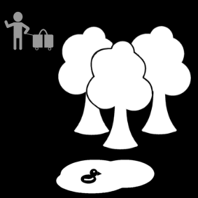
Nature

Slide 12
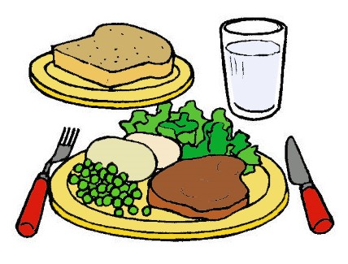
Food

Slide 13
What else?

Slide 14
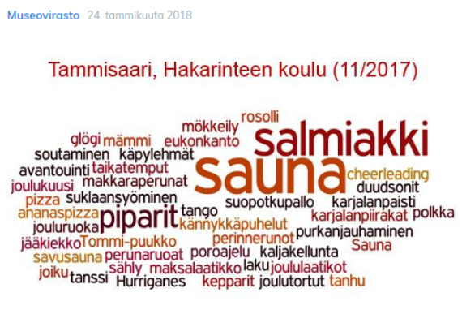
Can you find a familiar tradition?
christmas cookies, ice hockey, pineapple pizza, christmas tree, rowing, mulled wine, going to a cabin, Hurriganes, joiku, dance, liquorice, salmiakki, hobby horses, karelian pies, sauna, cheerleading

Slide 15
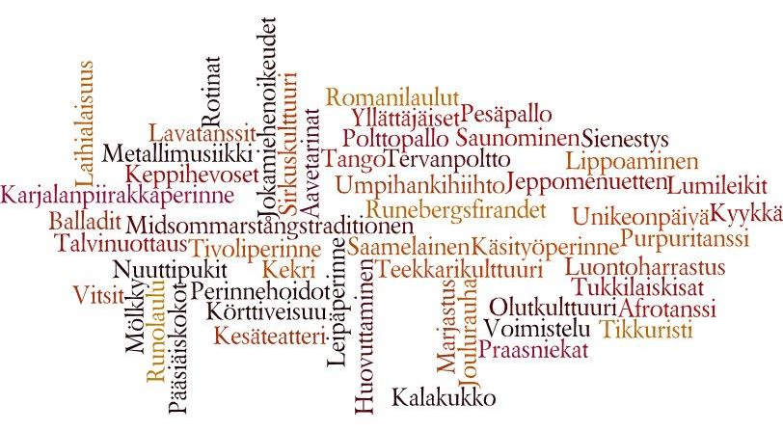
Can you find a familiar tradition?
Kekri - ancient Finnish harvest festival, circling amusement parks, karelian pies, being from Laihia, winter purse seining, Finnish baseball, tar burning, Roma songs, beer culture, kalakukko, mushroom picking

Slide 16
Break

Slide 17
Recap – how would you explain intangible/living cultural heritage?

Slide 18
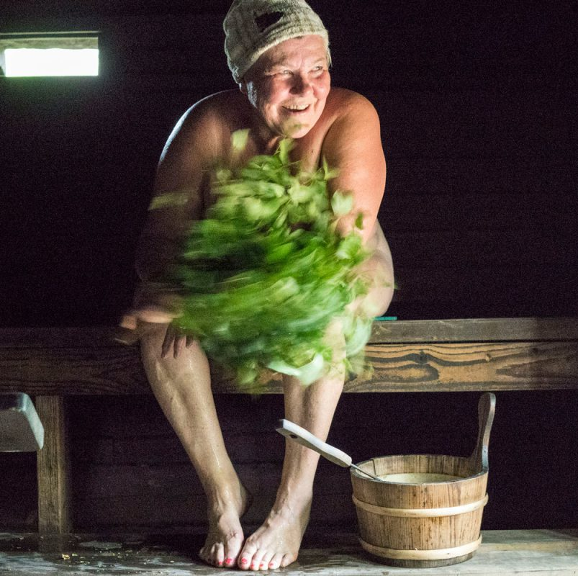
Finnish cultural heritage
https://www.youtube.com/watch?v=GLNVP1rPGLk
Photo: Hannu Pakarinen, Suomen saunaseura. MUSEOVIRASTO

Slide 19
Is there only Finnish cultural traditions in Finland?
Suomalainen elävä kulttuuriperintö on nyt listattu: saunominen, hautausmaalle jouluna...
https://yle.fi/a/3-9941646

Slide 20
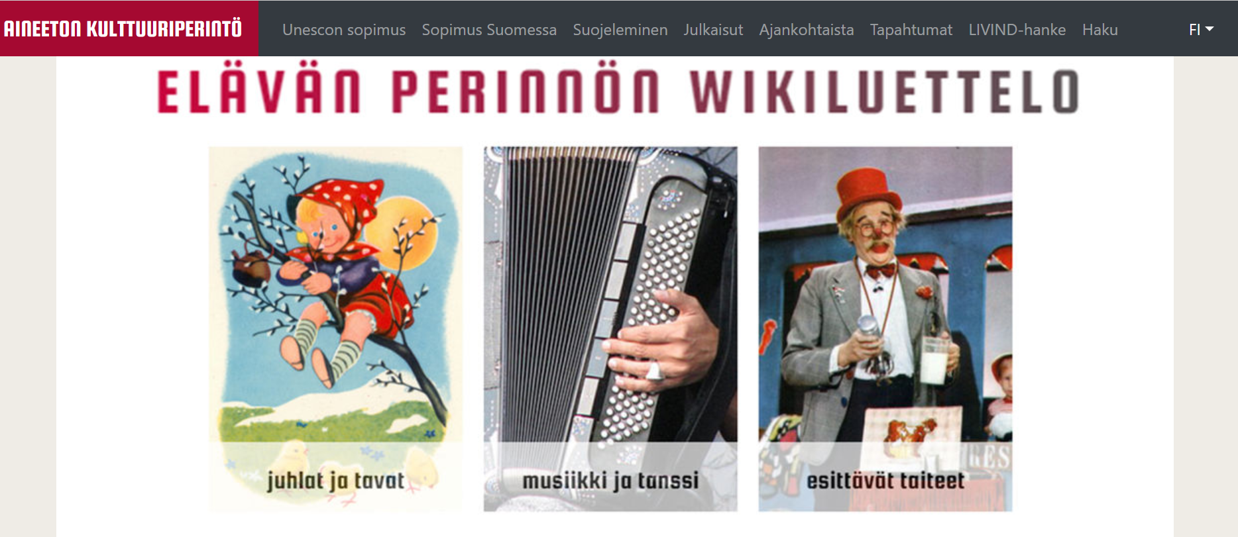
Wiki-inventory for Living Heritage
https://www.aineetonkulttuuriperinto.fi/fi/sopimus-suomessa/wikiluettelo

Slide 21
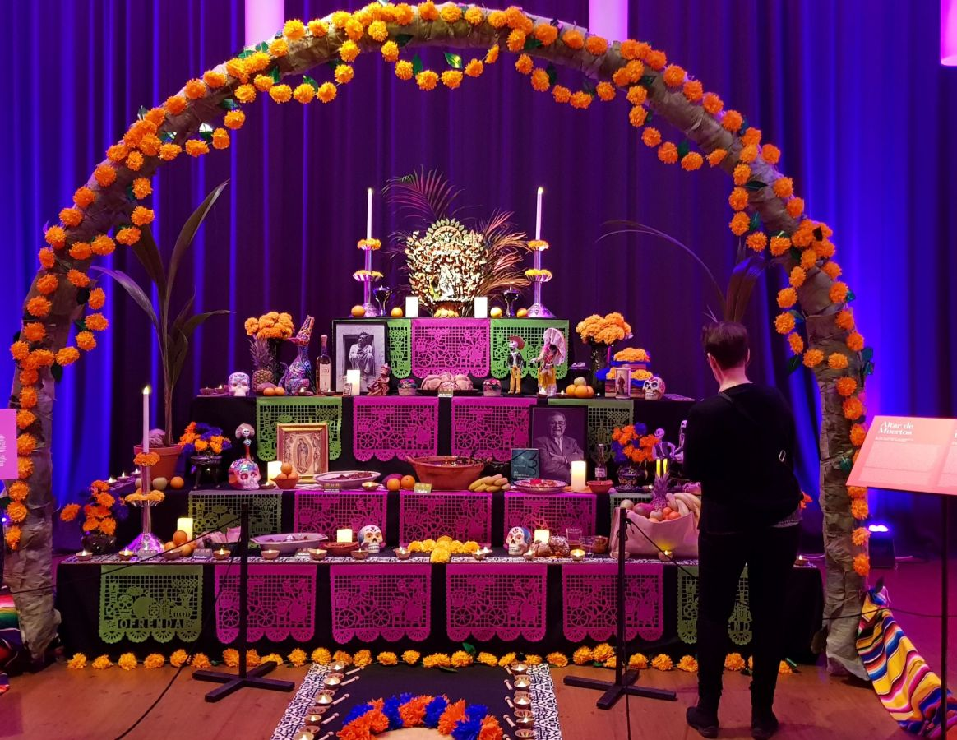
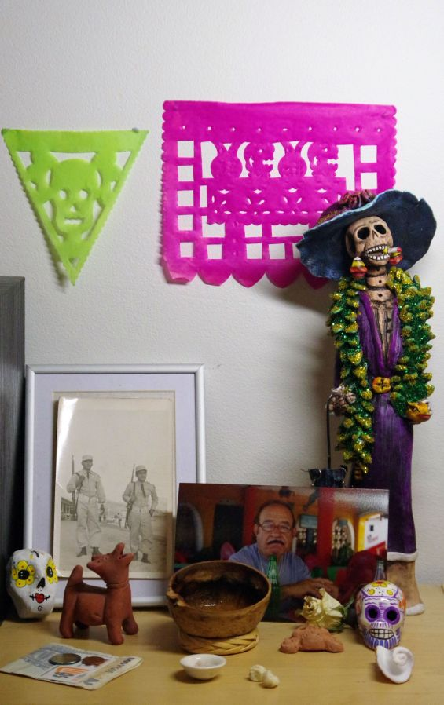
Day of the Dead in Finland
Meksikolainen alttari Kansallismuseossa
Kuva: Rosamaría Bolom
Meksikolainen alttari yksityisessä tilassa
Kuva: Rosamaría Bolom

Slide 22
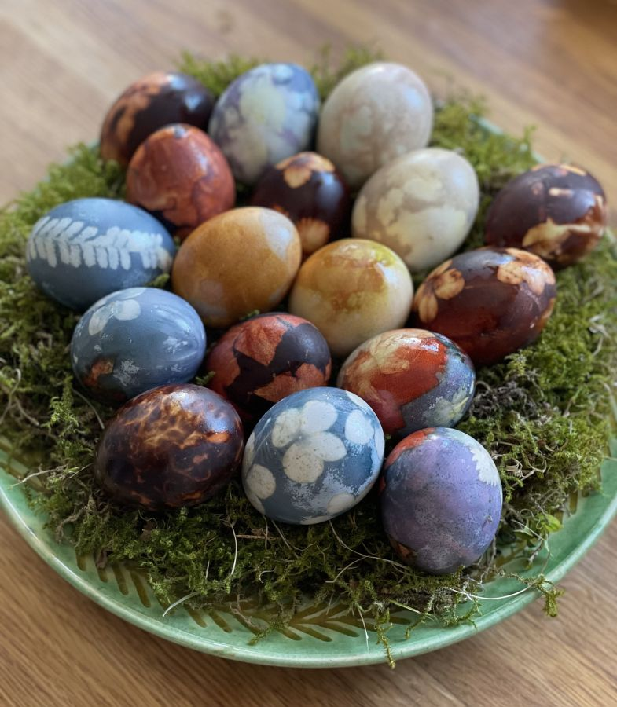
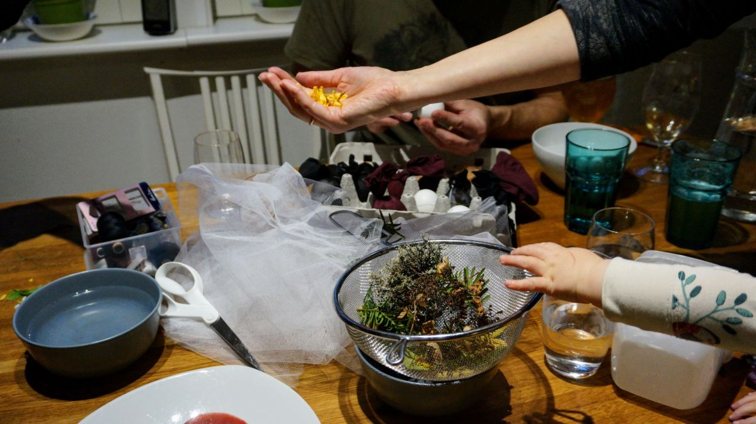
Latvian tradition of dyeing eggs in Finland
Process of decorating eggs, the night before Easter in the Latvian home
Easter morning with coloured eggs in the Latvian home

Slide 23
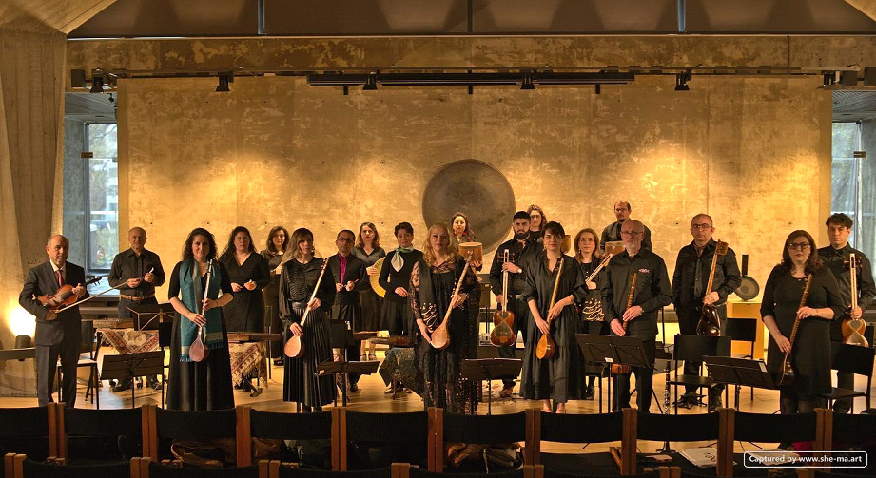
Iranian classical music in Finland
Aava music association in Turku, Finland, Photo: She-ma Semsa (She Semsar)

Slide 24
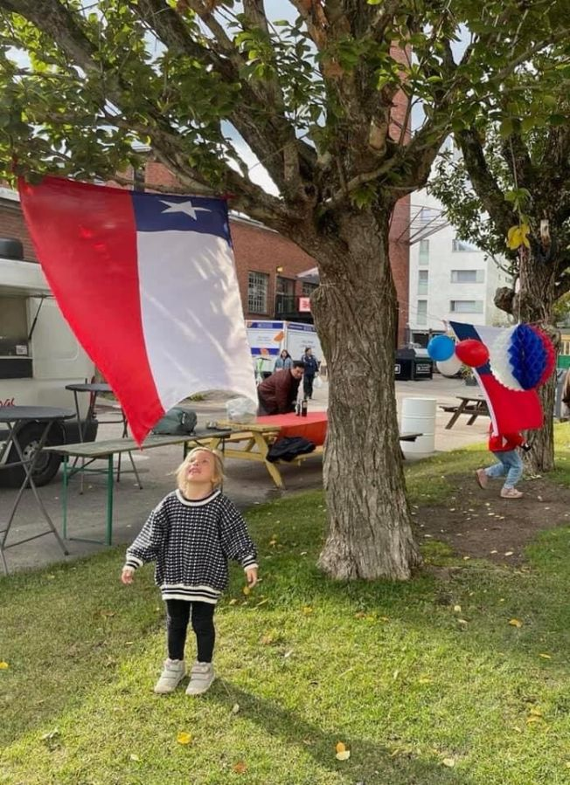
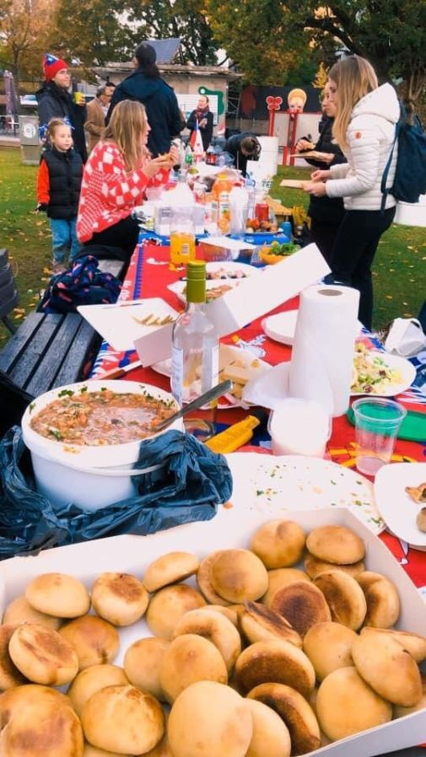
Celebrating Chile’s Independence Day "el Dieciocho" in Finland
Dieciocho at Kalasatama, photo: Claudia Lincopán Morales
Pan amasado and pebre Chileno, Photo: Claudia Lincopán Morales

Slide 25
Group work

Slide 26
Living cultural heritage
    Celebration
    Music and dance
    Performing arts (e.g. theatre)
    Stories
    Handicrafts
    Food
    Games
    Nature

Slide 27
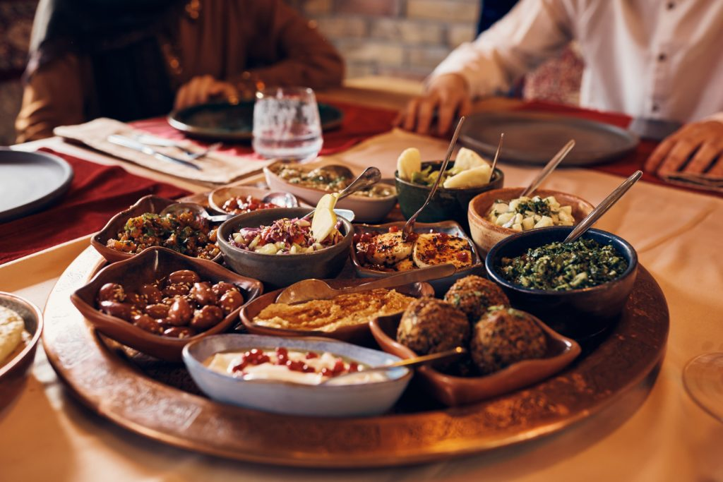
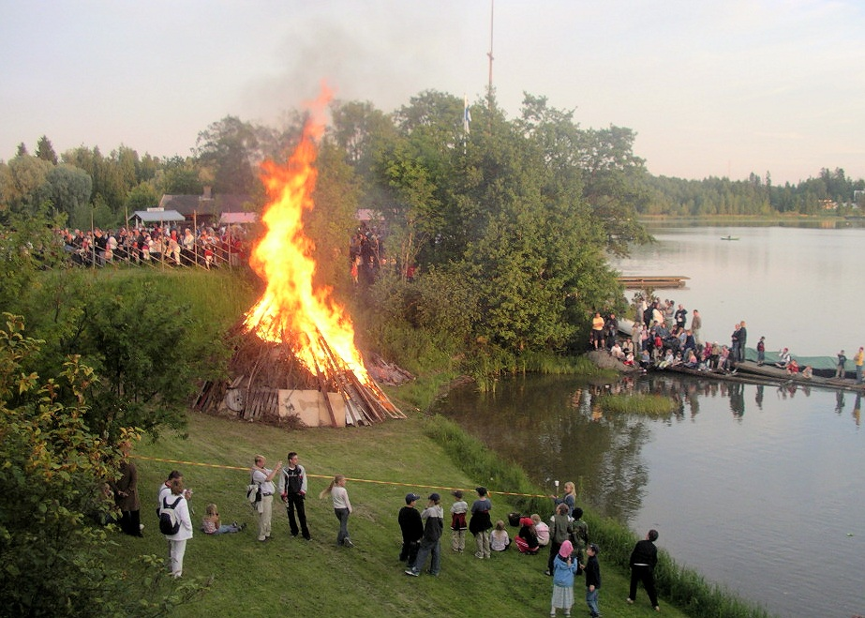
Can we find a tradition familiar to you?
    Music and dance
    Performing arts (e.g. theatre)
    Stories
    Handicrafts
    Food
    Games
    Nature
For example
Celebrations: ramadan and
midsommer
Who cherishes the tradition?
My neighbours.
Me with my family and friends.
What do you you?
I'll see what the others do. I myself will not participate. I would like to participate sometime.
We celebrate with friends. I cook and make decorations.

Slide 28
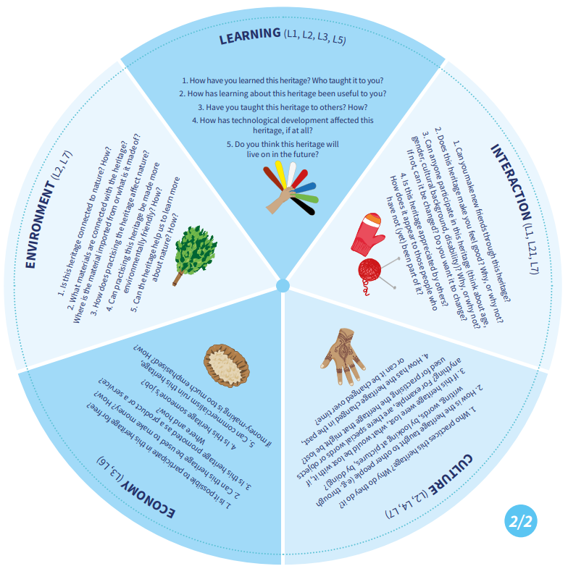
Choose one living heritage that is super important to you.
Spinner of living heritage: https://stpiensivustotprod.blob.core.windows.net/aineeton/Perintohyrra_web_EN.pdf

Slide 29
Homework – [date of the next workshop]
For next time, bring something of your own living heritage (object, picture, story...) that you will present in the group next time

Slide 30
Follow up questions
This "own" cultural tradition I want to pass on to my children (and other Oulu residents)
This is the cultural heritage I want to pass on to my children.
This is the Oulu/Finnish tradition I want to try
What have you noticed that’s the same in Oulu/Finnish cultural heritage and in your own cultural heritage?

