Slide 1
Intangible Cultural Heritage
Workshop 2

Slide 2
What do you remember from the first workshop?

Slide 3
Card game
Everyone chooses an interesting card and presents the card to the whole group.
Tell us why you chose the card, what do you know about the tradition, why is it interesting?

Slide 4
Homework: Presentations

Slide 5
Culturally diverse cultural heritage in Finland

Slide 6
How can cultural heritage be shared with others?

Slide 7
Events

Slide 8

World Village Festival
Helsinki
https://www.youtube.com/watch?v=ppoNq-RsQ4E

Slide 9
Chinese New Year
Helsinki
https://www.youtube.com/watch?v=I0ugoEDlnCo

Slide 10
Latin Folk Night
Helsinki
https://www.youtube.com/watch?v=WuD9oJpyjTs

Slide 11
Kolibri – Cultural Diversity Festival for Families
Espoo – Vantaa – Helsinki
https://www.youtube.com/watch?v=sw9YYI5UXNw

Slide 12

International Arabic Language Day 18.12.
An event organized by Familia ry in 2023

Slide 13
Being black – Afro Finns’ Experiences
https://www.helsinginkaupunginmuseo.fi/en/2023/04/20/being-black-afro-finns-experiences-represents-a-diverse-helsinki/

Slide 14
How about in your area?

Slide 15


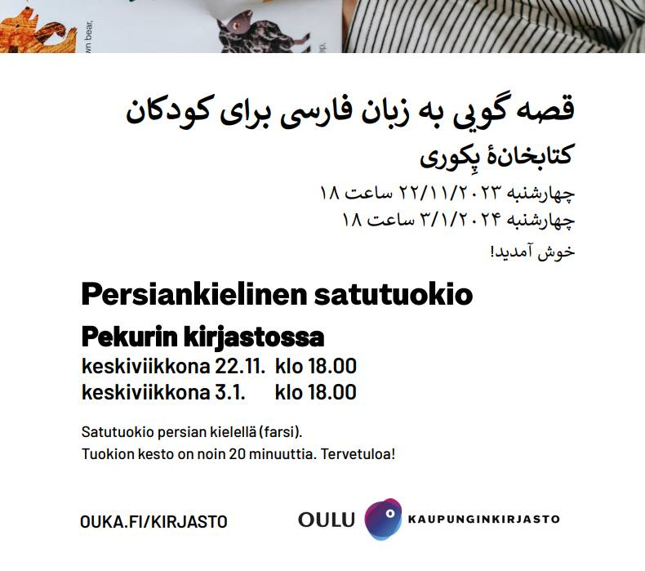
Present events promoting cultural diversity in your area, here are examples from Oulu

Slide 16
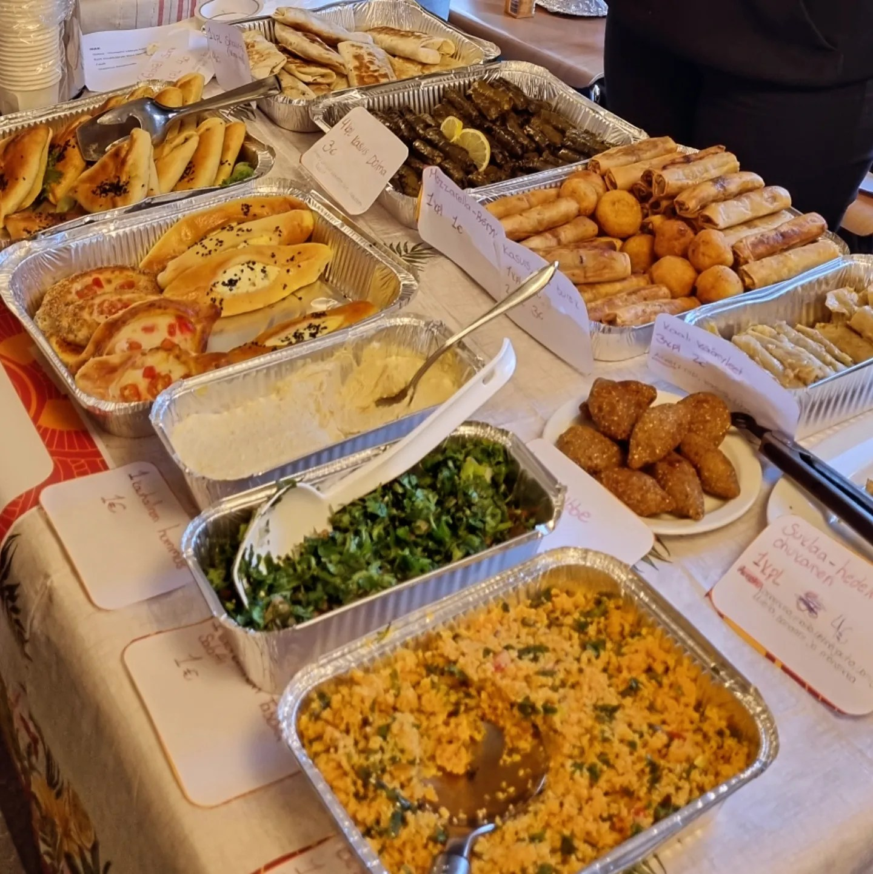

Present events promoting cultural diversity in your area, here are examples from Oulu

Slide 17
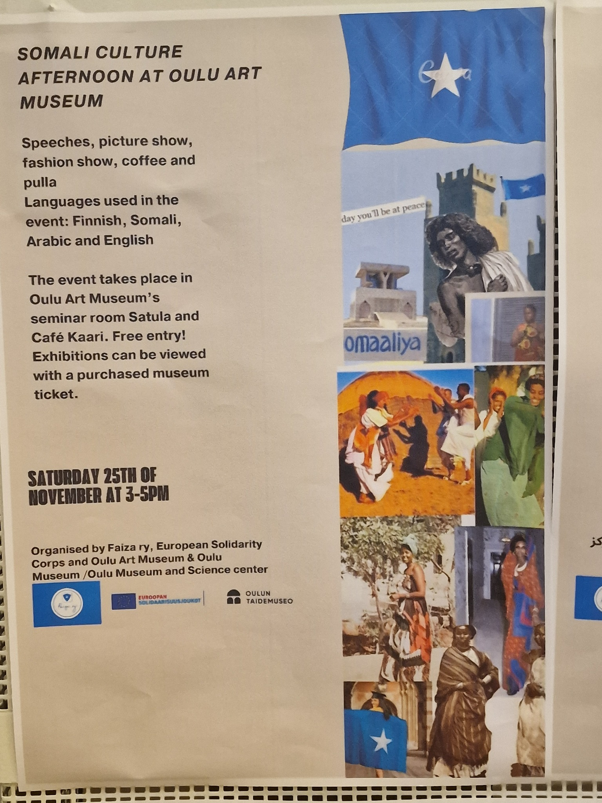
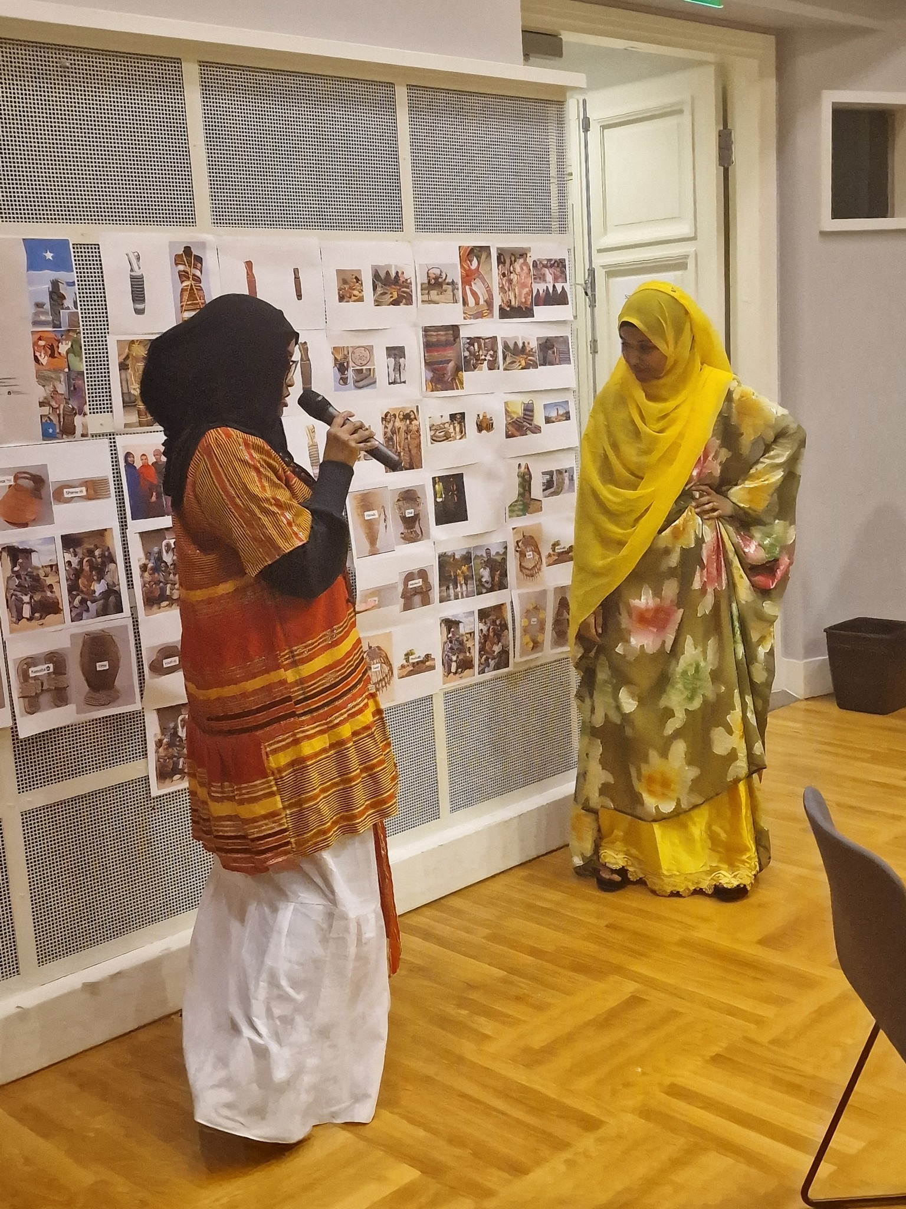
Present events promoting cultural diversity in your area, here are examples from Oulu

Slide 18
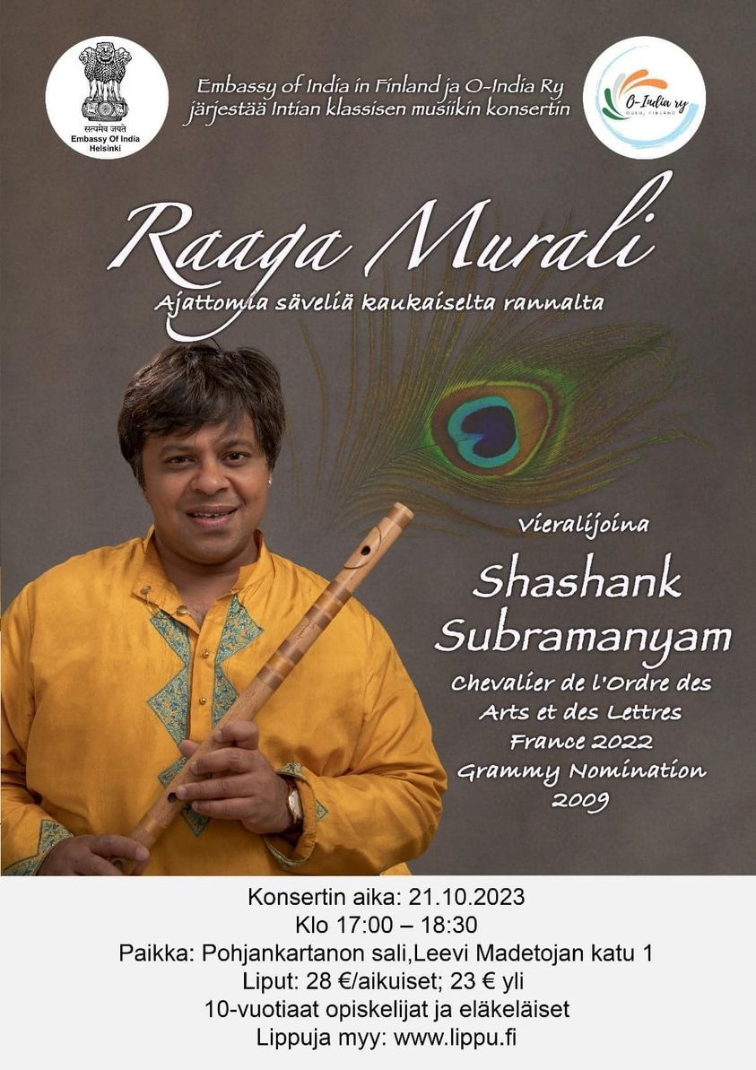
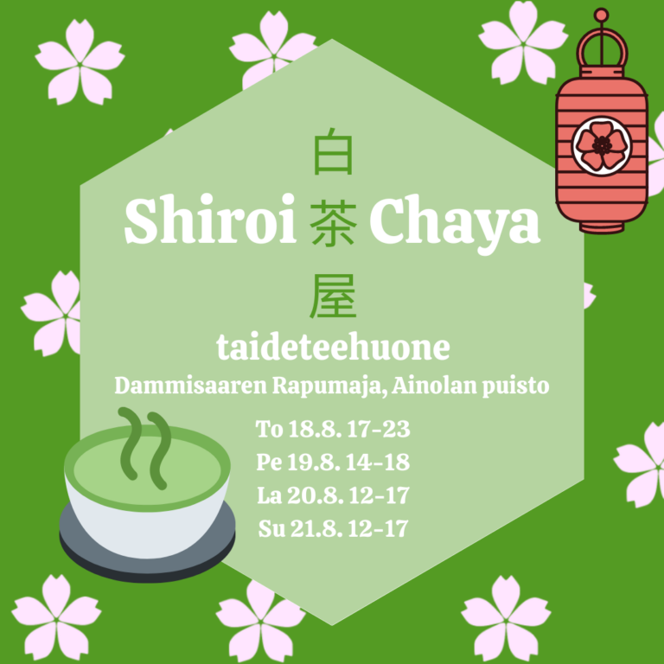
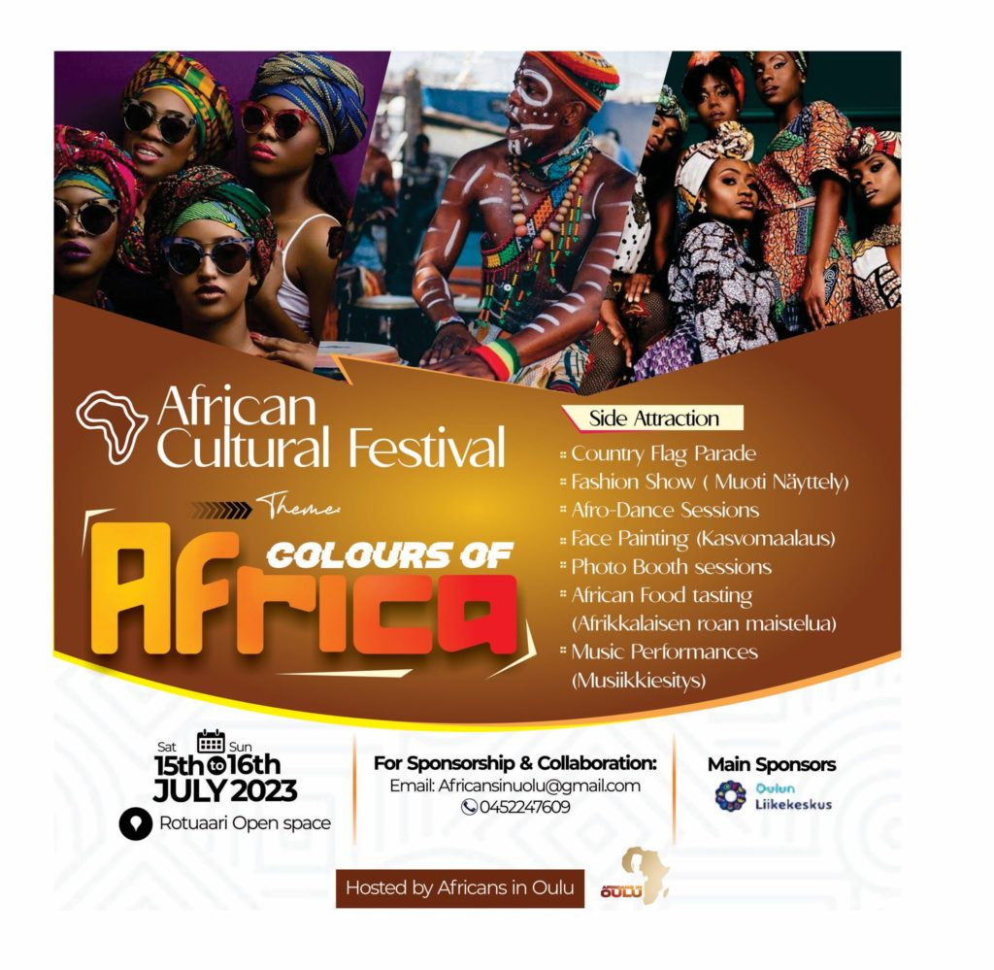
Esittele kulttuurista moninaisuutta edistäviä tapahtumia paikkakunnaltasi, tässä esimerkkejä Oulusta

Slide 19
Group assignment
Let’s design a cultural event in groups.
What would you like to participate in?
What would you like to organize yourself?

Slide 20
Cultural event
Each group chooses one event.
What kind of cultural heritage: celebration, craft, dance, stories...
What event: e.g. craft workshop, festival, concert…
For whom, e.g. whole family, young people, women?
Name of the event?
Duration of the event, E.g. 2 hours, whole day
Where? E.g. museum, Cultural Centre Valve, library?
When?

Slide 21
End discussion
What ideas did the workshop evoke?
What did you learn?
What would you like to know more about?

