Slide 1


Oulu - Lukevin kaupunni!

Slide 2


European Reading
Capital of Culture
The Lukevin kaupunni Campaign encourages reading and promotes multiliteracy. Its goal is to make Oulu the European Reading Capital of Culture.
We create a culture of communal reading and promote the multiliteracy skills of citizens.
Lukevin kaupunni is also a communications and marketing campaign.
Let's pursue Oulu's literacy work and describe the coming European Reading Capital of Culture!
  #LukevinKaupunni
  #EuroopanLukevinKulttuuripääkaupunki
  #OuluLukee
  #Oulu2026

Slide 3
Reading & Library Cooperation Steering Group coordinates the campaign
Members:
Harri Kauppinen, Head of Area, chairperson
Helena Valtakorpi, Information Specialist, Oulu School Library, secretary
Marjut Nurmivuori, Basic Education and Youth Manager
Juha Aho, Development Director
Pauliina Kanervo, Director of Pedagogy
Aro Rissa, Basic Education Principal
Jouni Pääkkölä, Library Service Manager, Oulu City Libary
Mikko Paajala, Service Manager, Oulu City Library
Elina Kauppila, Head Information Specialist, Oulu City Library
Sari Nyberg, Early Childhood Education Head Specialist
Juha Alatalo, Project Designer
Marjo Immonen, Personnel Specialist
Tanja Salo, Development Teacher, literacy promotion
Maikki Manninen, Development Teacher, ICT, digitality, STEAM
Satu Jehkonen, Development Teacher, school and culture
The city of Oulu's literacy work and literacy strategy's steering group.
Goal of the activities:
Development and coordination of the literacy of citizens of different ages
Maintaining and reinforcing the structures of literacy work
The Steering Group promotes cooperation with early childhood education, basic education and upper secondary education.
Reading & Library Cooperation | Lukevin kaupunni | City of Oulu

Slide 4

National Literacy Strategy
Lukutekojen Oulu – Literacy Strategy 2026 Project
The city of Oulu has received an aid of 43 734 € from the Finnish National Agency for Education. The project period is August 2025 – December 2026. Oulu will develop its own Literacy Strategy that will promote equality: readers of all ages and people who need special literacy support and foreign language speakers will be considered.
National Literacy Strategy 2030
Literacy Programme, Finnish National Agencty of Education (in Finnish), is responsible for the implementation of the strategy.
Reading Municipality (in Finnish)
Reading Early Childhood Education (in Finnish)
Reading School (in Finnish)
Kuva: Kansallinen lukutaitostrategia

Slide 5
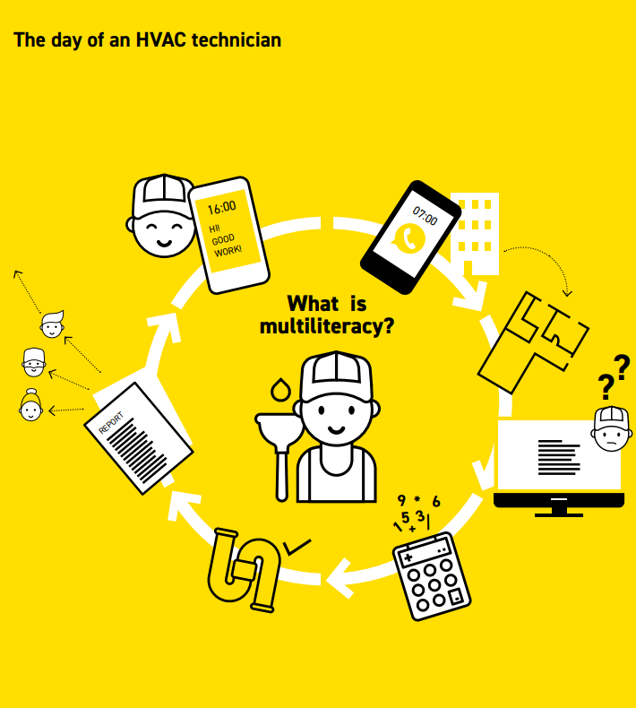
Multiliteracy
Includes all different forms of literacy from traditional reading and writing skills to media literacy, visual literacy, data literacy and more.
The concept of multiliteracy includes the idea that all forms of literacy are equally valuable and needed.
Multiliteracy creates the skills to live in modern society and prevents social exclusion.
The word literacy is used generally to refer to the field of multiliteracy – also in this presentation.
Image: National Literacy Strategy

Slide 6

Literacy in City Documents
"Oulu is an active operator in the National Literacy Strategy's Lukeva kunta Network."
Oulu City Strategy 2030
"The city of Oulu is committed to the National Literacy Strategy and promotion of citizens' literacy. The goal is to offer every citizen of Oulu strong literacy and a good life."
City of Oulu's Wellbeing Plan
"Oulu is European Reading Capital of Culture. Each citizens of Oulu feels that they are a part of the coming Capital of Culture."
Oulu oivaltaa – Education Programme 2024-2027.
Picture: Oulu City Library / Juha M. Kinnunen

Slide 7


Slide 8
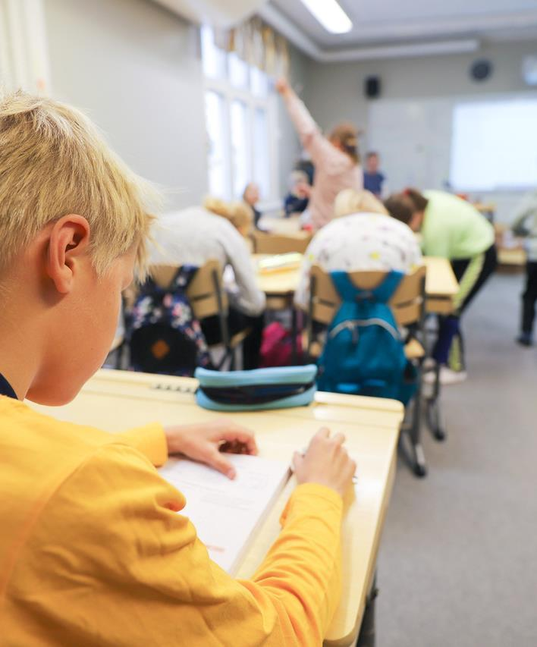
Highlighting Oulu's Literacy Operators
Communications themes for early 2025:
Early childhood education services: literacy work as one theme 01/2025. Early childhood education builds a strong base for children's literacy skills (in Finnish)
Digital Support, digital skills, Oulu's digital support network and the Digital Skills Challenge 02/2025
Literacy work in schools and upper secondary schools 03/2025
Nature and nature literacy 04/2025
Word art and Lumotut sanat 05/2025
Read more about Oulu's literacy activities:
Oulu Reads | Lukevin kaupunni – The Reading Capital | City of Oulu
Kuva: Oulun kaupunki / Minna Mäki-Heikkilä

Slide 9
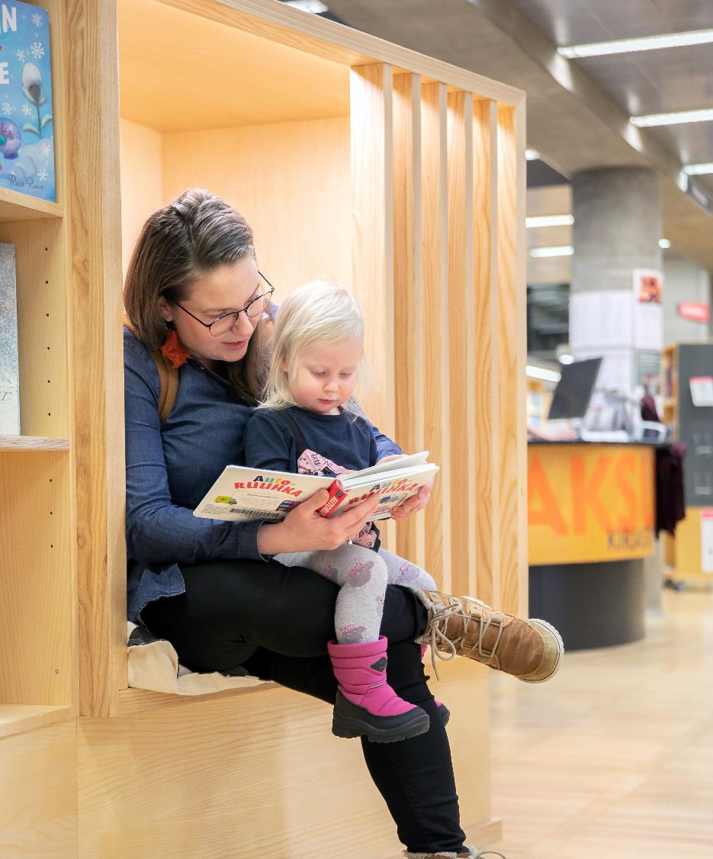
Centering Children and Youth
Schools promote reading actively. Oulu's school library network is unique.
Oulu City Library's children and youth collection increased 10 %
Schools and upper secondary schools participate actively in the City Library's Library Route activities which reached 27 430 children and young people in 2024. The attendee numbers grew 18,2 % from last year.
The PISA 2022 results for Oulu's schools were good. The city of Oulu's PISA literacy average was 527 points. Finland's national average was 490 points, and the average of OECD states was 476 points.
Books are present throughout early childhood education. Cooperation with libraries is active and the Joy of Reading activities reached 15 595 children in 2024. The attendee numbers grew 14,7 % from last year.
Youth Services and other operators also promote literacy.
Picture: Oulu City Library / Juha M. Kinnunen

Slide 10
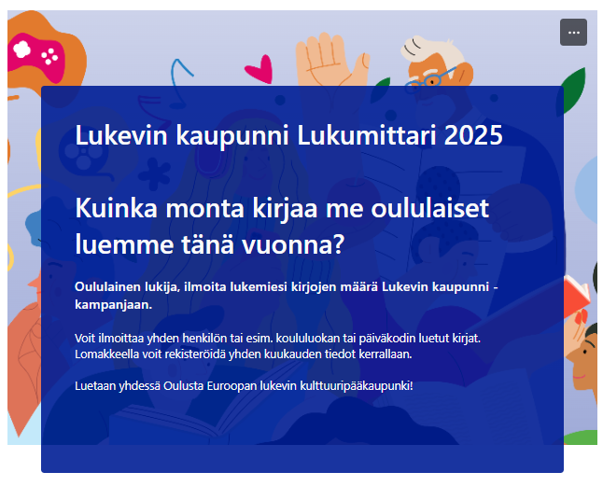
Reading Counter
How many books do citizens of Oulu read or listen to in 2025?
Can we figure out where in Oulu people read the most?
Let's get the counter rolling and make Oulu the European Reading Capital of Culture by reading! Prizes are raffled among participants.
The Reading Counter is found online: Reading Counter | Lukevin kaupunni – The Reading Capital | City of Oulu.

Slide 11
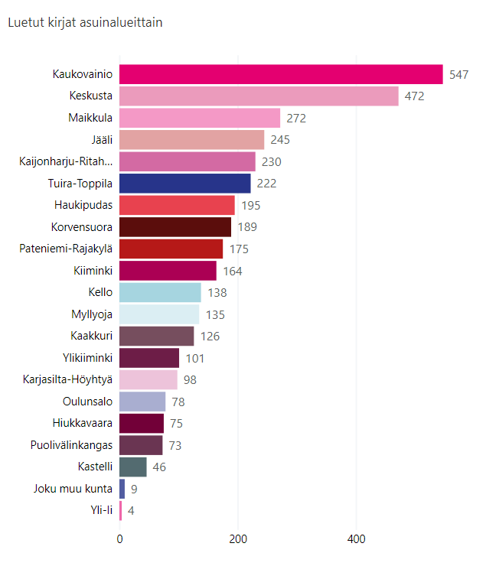
Reading Counter
February 12, 2025
Total read books
3594
Total readers
1199

Slide 12

Lukevin kaupunni Website
The Campaign's website is found in the address:
ouka.fi/en/lukevinkaupunni
Presentation of the Campaign and instructions
Marketing materials
Oulu's literacy operators
Ready – Set – Read! Challenges
Digital Skills Challenges
Nature Skills Challenges in April

Slide 13

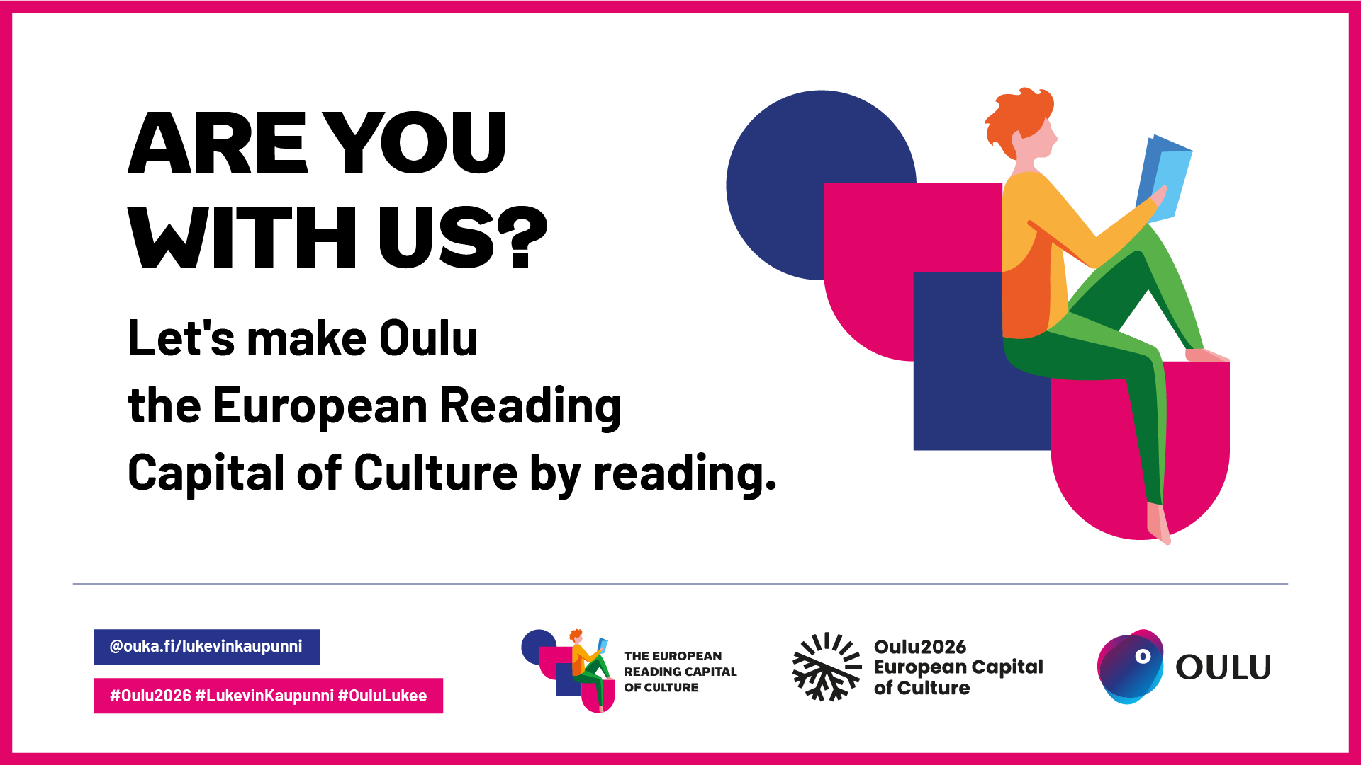




Join us easily with prepared materials!
Marketing materials are found on the website: Marketing Materials | Lukevin kaupunni – The Reading Capital | City of Oulu

Slide 14

Get in touch!
We will happily tell you more about the Literacy Strategy and the Lukevin kaupunni Campaign.
Tanja Salo, Development Teacher, literacy promotion, Educational and Cultural Services, tanja.salo@ouka.fi
Elina Kauppila, Head Information Specialist, Oulu City Library, school cooperation, elina.kauppila@ouka.fi
Mikko Paajala, Service Manager,
Oulu City Library, mikko.paajala@ouka.fi
Presentation materials are found on the website: Presentation Materials | Lukevin kaupunni – The Reading Capital | City of Oulu

