Slide 1
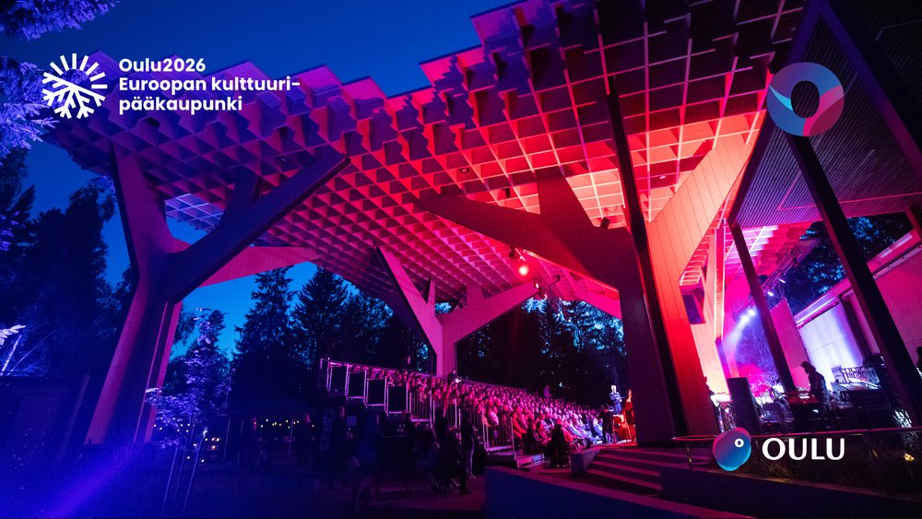
Hupisaari Open-Air Theatre
Venue info

Slide 2
Contacts
Maintenance, cleanliness and waste management of the area:
Oulun Tilapalvelut / Markku Rajala markku.rajala@ouka.fi +358 40 655 1917
Property maintenance on-call: +358 44 703 2598
Theatre building and stand cleaning
Luotea / Tiina Tolonen tiina.tolonen@luotea.com +358 50 385 3060
Technical support for sound equipment and electric trusses:
Oulun Kongressitekniikka / Jouko Kettunen jouko.kettunen@oktoy.fi +358 40 5532473
Theatre reservations: City of Oulu / Event Area Services /
  Helena Mäkinen helena.makinen@ouka.fi +358 40 194 5989
  Jari Leviäkangas jari.leviakangas@ouka.fi +358 703 8101

Slide 3
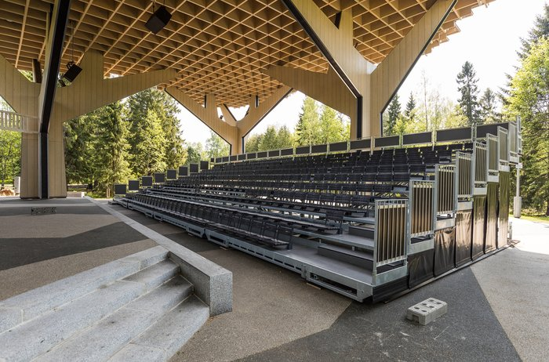
Audience Stand Information
Seating capacity: 310
  If the theatre’s own tech table is used and placed in the audience stand, capacity decreases depending on location:
    approx. 10 seats in the middle
    approx. 7 seats in the corner
Wheelchair spaces are located at the front on asphalt (number and placement defined by organiser)
Induction loop in use summer 2026 (covers first 5 rows)
  Must be connected to the mixing console pre‑show and turned off afterwards
  Organiser must ensure instruments/tech do not interfere with the induction loop

Slide 4
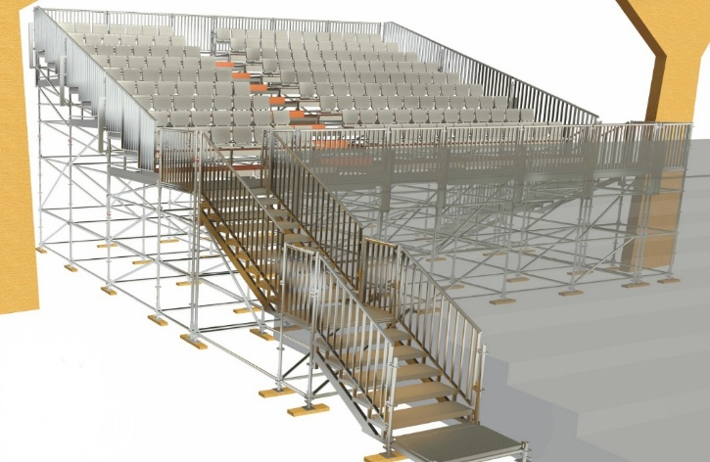
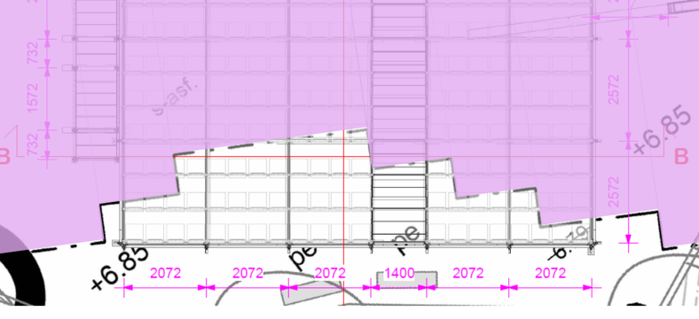
Additional Stand Summer 2026
Capacity: 180 paikkaa
Built in May, dismantled in September 2026
Please note: not all seats in the last three rows are covered by the canopy structure. The canopy is indicated as shaded in the layout drawing, and the final implementation may differ from what is shown
The additional seating structure prevents vehicle access to the side of the stage; this must be taken into account during event setup and dismantling
Equipped with exterior cladding

Slide 5
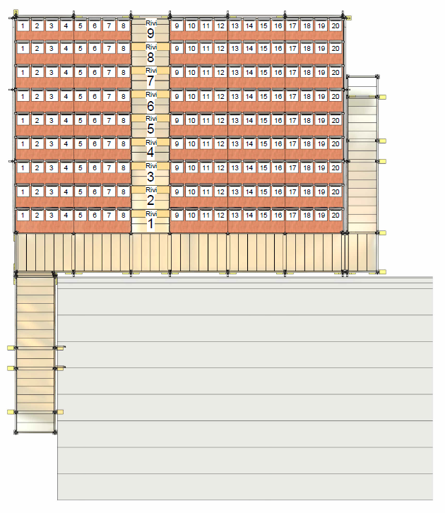
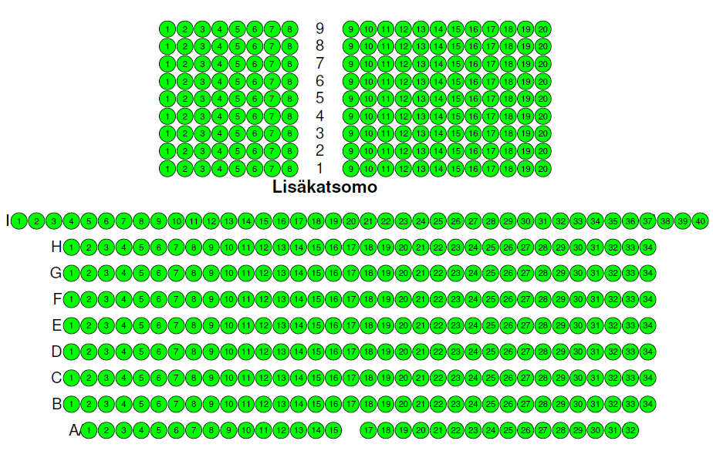
Row and seat numbering
Source: Lippu.fi

Slide 6
Ticket Sales, Café and Beverage Service
Ticket Sales
  The theatre does not have an agreement with any specific ticketing provider, so the event organiser may arrange ticket sales in their preferred way.
  The ticket booth has an internet connection.
Café and Beverage Service
  The event organiser may operate the café themselves or make arrangements with Kahvila Kiikku, which is active in the area. Contact: Rina Hirviniemi I kahvilakiikku@gmail.com +358 45 132 8806
  The theatre building has a small kiosk equipped with a refrigerator, freezer, microwave, and coffee maker (2 machines). This may suffice for a small audience or can be used for backstage catering.
  In summer 2026, due to the additional seating structure, there will be no space on the asphalt area for café operations. Practically, the only way to serve a large audience is through cooperation with Kahvila Kiikku.
  A permanent licence for a licensed beverage area has been granted for the site (AVI, licence number 34063252).
  Beverage service may be organised by any operator chosen by the event organiser who holds a valid serving licence.
  The licence holder must notify AVI about the beverage service.

Slide 7
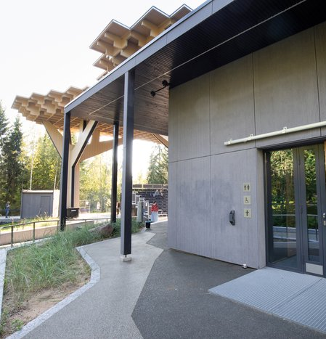
Facilities and Equipment
The theatre building has two dressing rooms for performers, each with its own toilet and shower facilities.
Audience Toilets:
  Women: 2
  Men: 2 plus 2 urinals
  Additionally, 1 accessible toilet
The theatre has 5 white fences for delimiting the area, and an additional 10 fences for other uses.
There are 10 bar tables available for the event organiser’s use.
Near the theatre entrance, there is a white notice board for event announcements. The board is opened with a window opener located in the theatre’s kiosk.
Keys and Responsibilities
Keys are handed over and returned at the Ouluhalli service point. The applicant and time must be agreed in advance with the event coordinator, Helena Mäkinen.
The event organiser is responsible for any lost and found items from visitors.

Slide 8
Lighting
The general lights are controlled by buttons located on the wall of the kiosk booth.
The lighting groups are: stage, audience area, and ambient lighting.
There are several preset options for the colored lights; by pressing the button repeatedly, you can select the most suitable one.

Slide 9
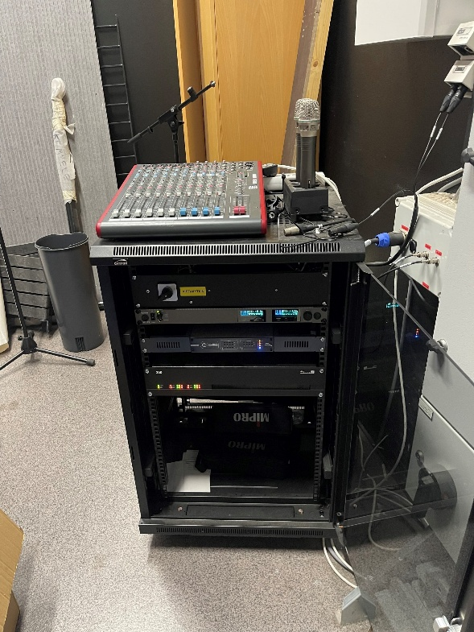
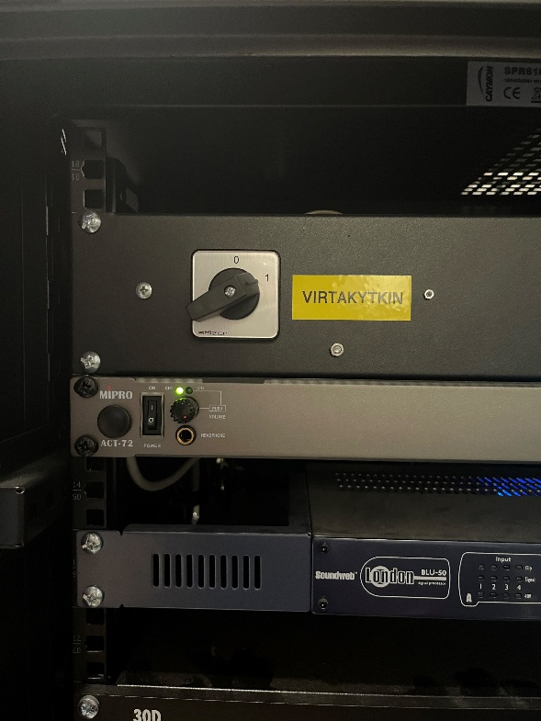
Hupisaaret Sound System 1/2
1. Turn on the power using the switch

Slide 10
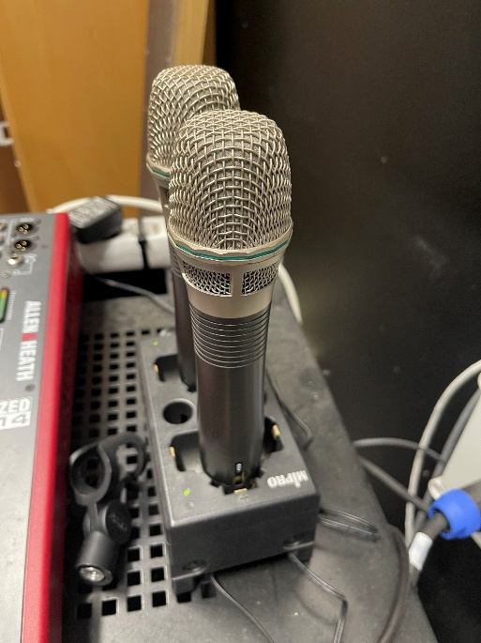
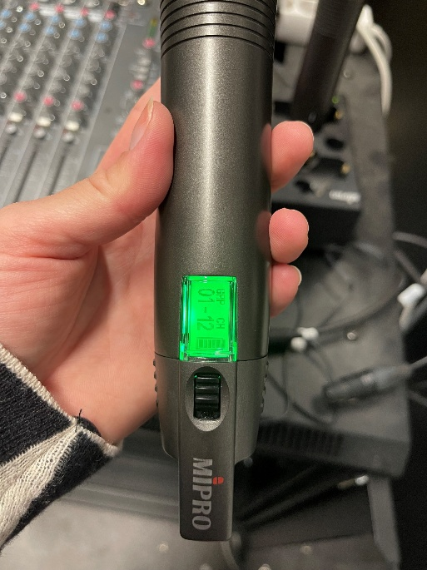
Hupisaaret Sound System 2/2
2. Turn on the microphone (connection may take a few minutes)
3. Return microphone to charger and turn off system afterwards

Slide 11
Required Permits and Safety Plan
Police event notification required for events over 200 people or with special security needs
Noise permit required if amplified sound used after 22:00
The serving licence is applied for from the Regional State Administrative Agency (AVI). The theatre area has already been approved as a licensed beverage area, so the operator chosen by the event organiser who holds a valid licence only needs to notify AVI about the beverage service.
Permits must be obtained for the use of adjacent areas if your event will make use of the islands/areas next to the theatre.
Safety plan required for events over 200 people; organiser must review theatre safety plan and brief staff; send plan to pelastuslaitos.palotarkastaja@pohde.fi

Slide 12
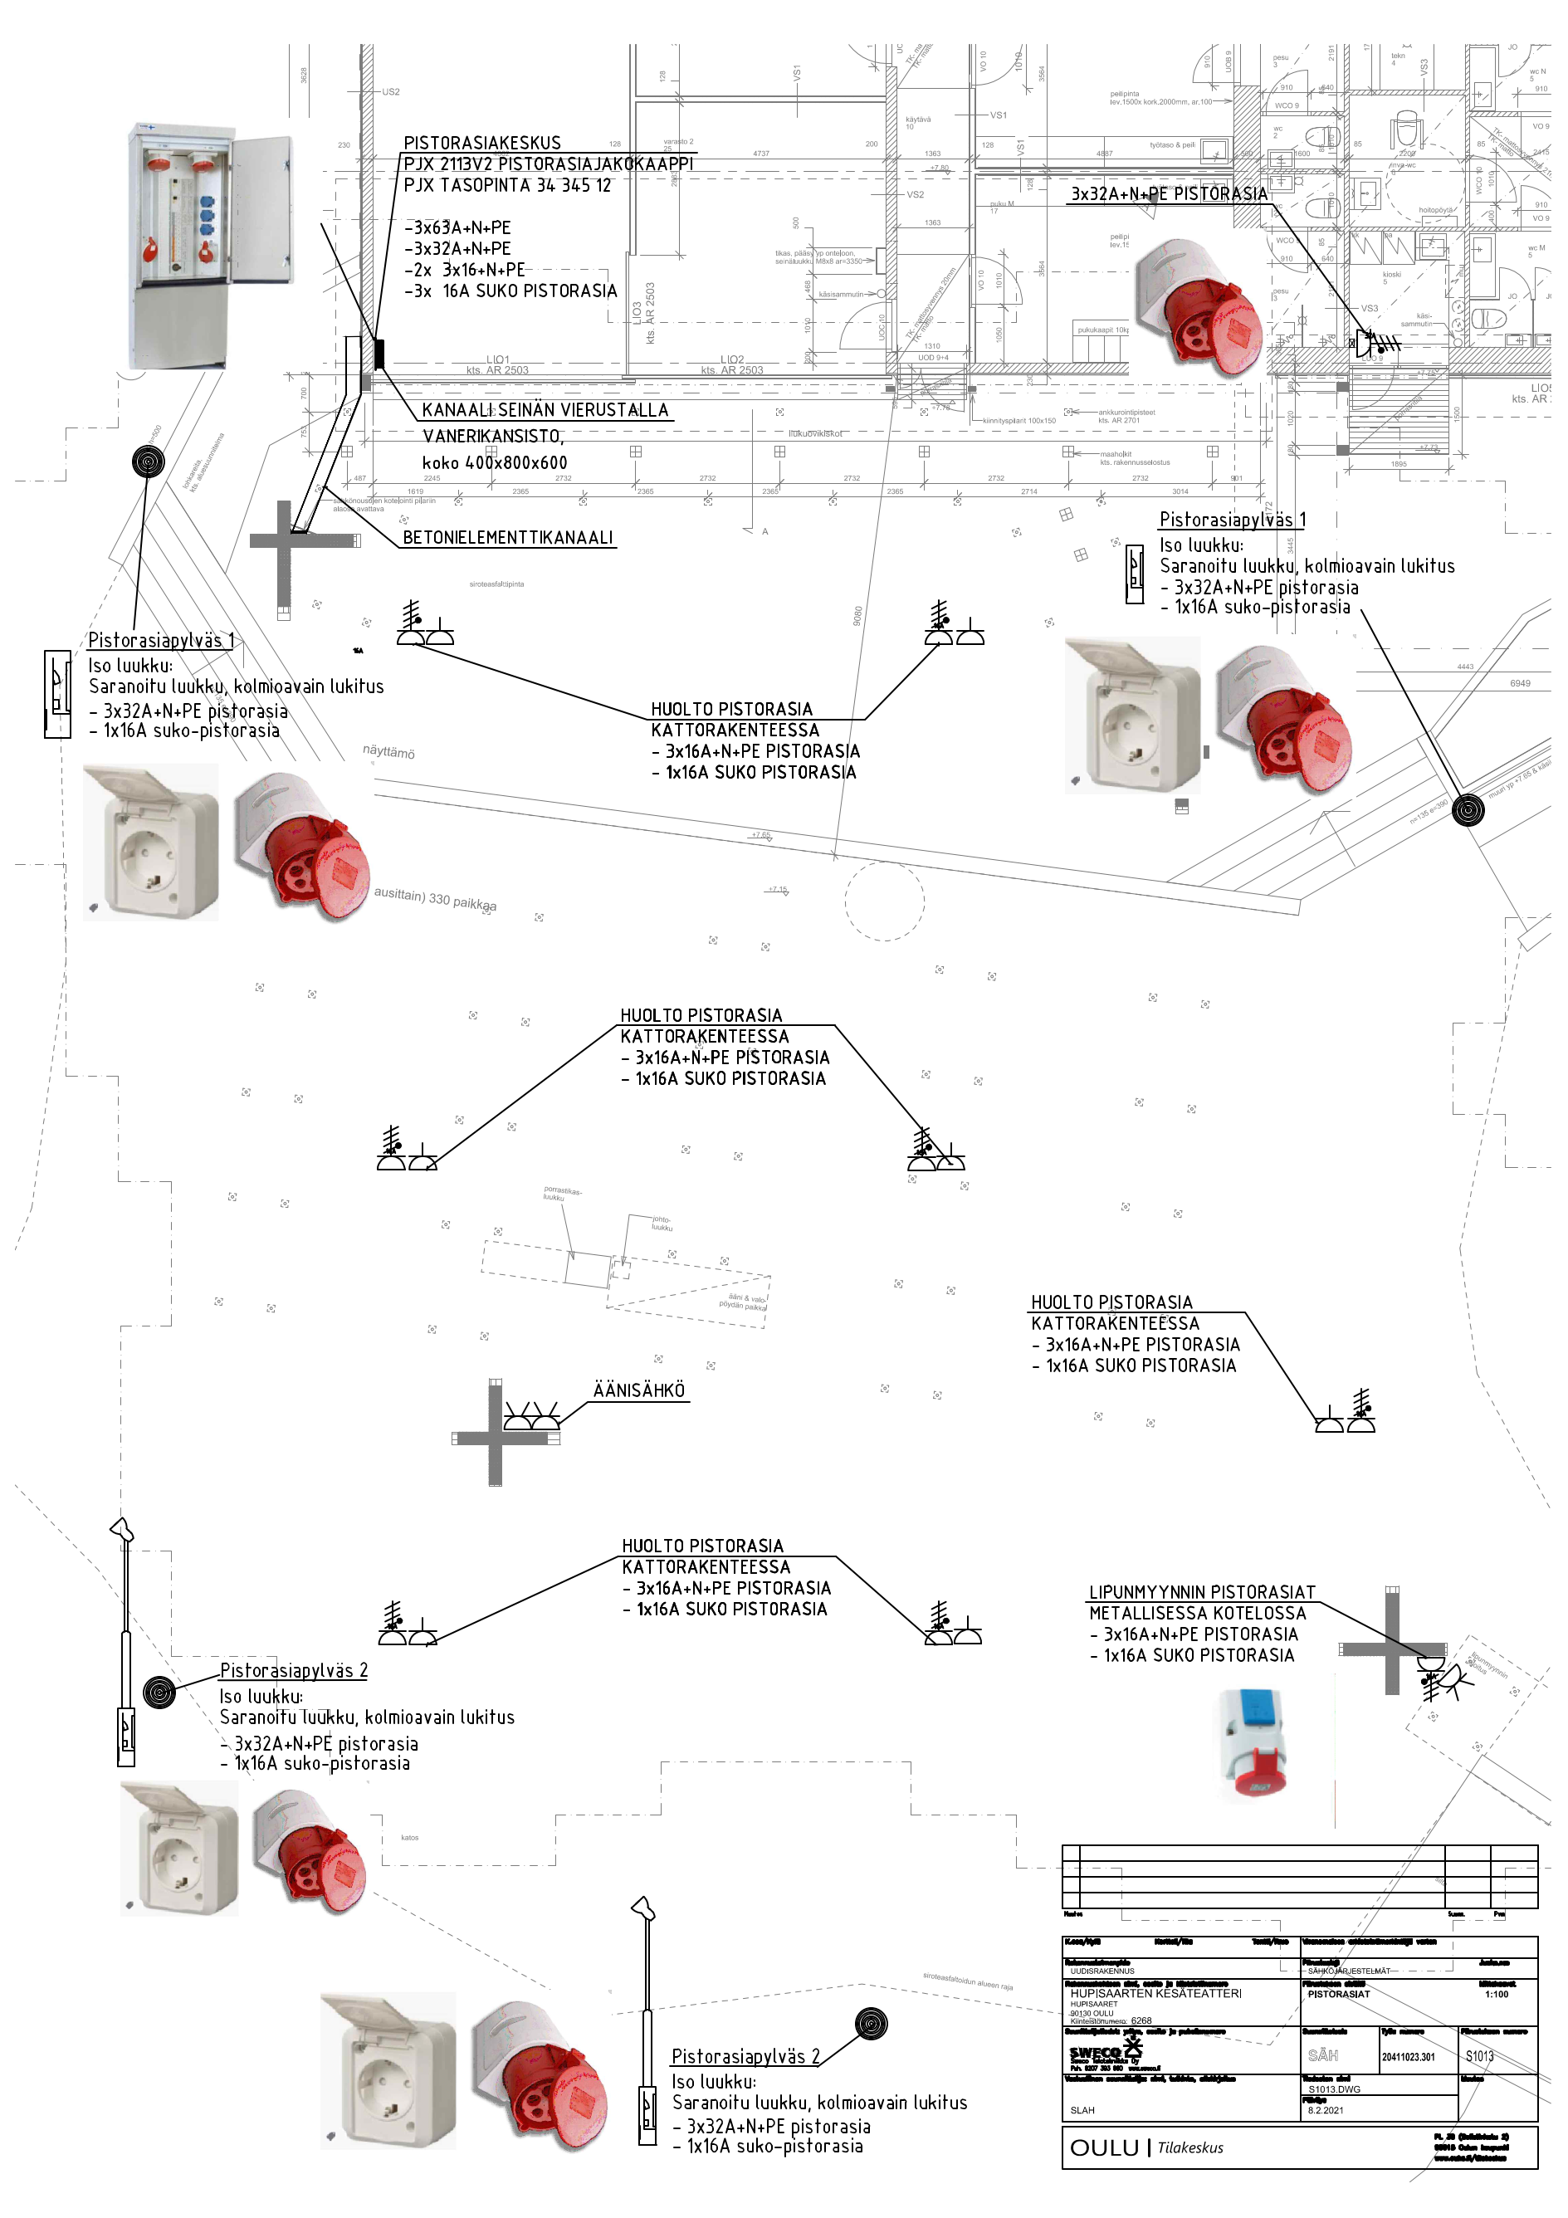
Electrical Systems

Slide 13
Sound Equipment List
d&b audiotechnik 24S‑D TOP (2 units)
- 2 x 12"/1.4”
- Dispersion 110 x 45 ast
- SPL Max 137dB
d&b audiotechnik 21S SUB
- 1 x 21”
- Omni directional
- SPL Max 135dB
d&b audiotechnik 30D amplifier
- 4 x 1600W / 4ohm
BSS Blu 50 audio processor
- 4 in / 4 out
Mipro ACT 72 microphone system
- 2 × ACT 72HC mics
- 1 × MP‑80 charger
Allen & Heath Zed 1402 mixer
- 6 mic/Line in 4 stereo in

Slide 14
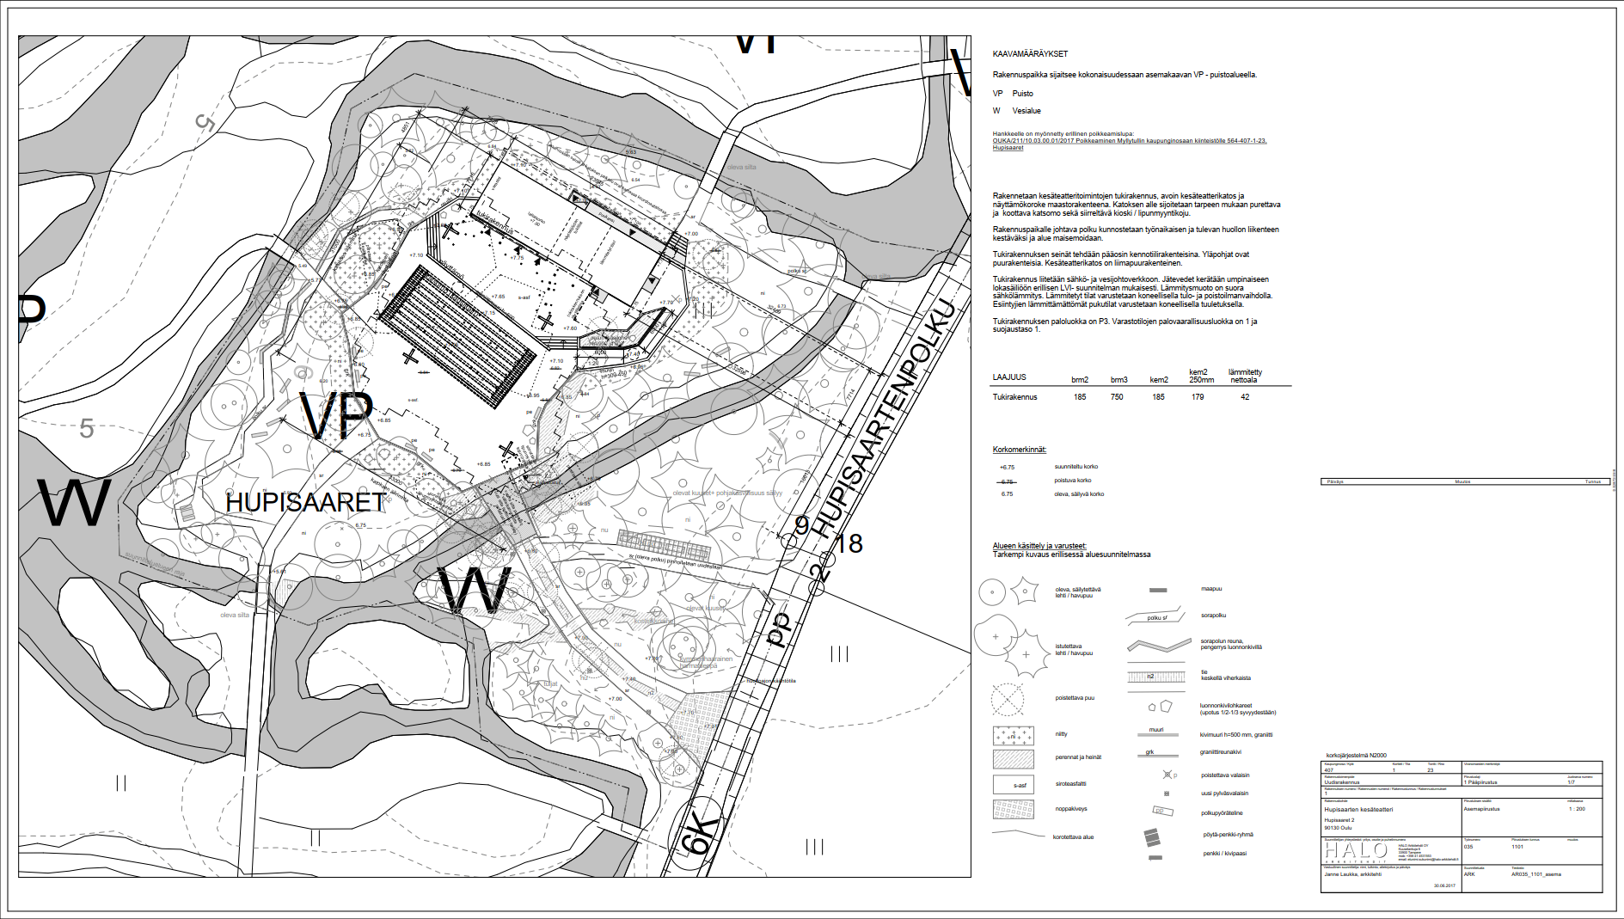
Site layout drawing

Slide 15
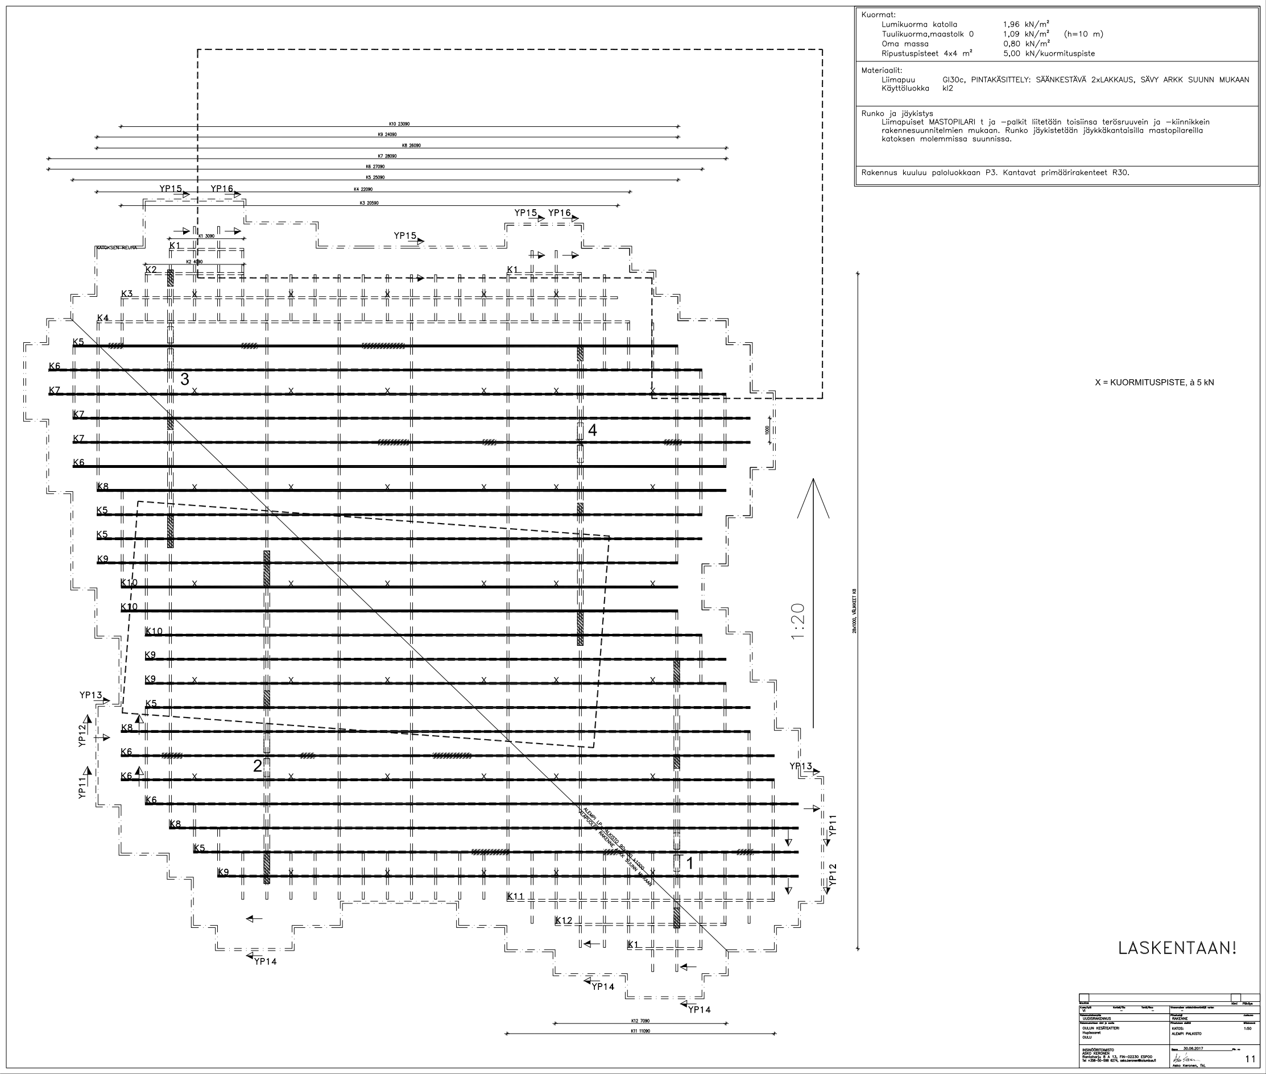
Canopy suspension points

Slide 16
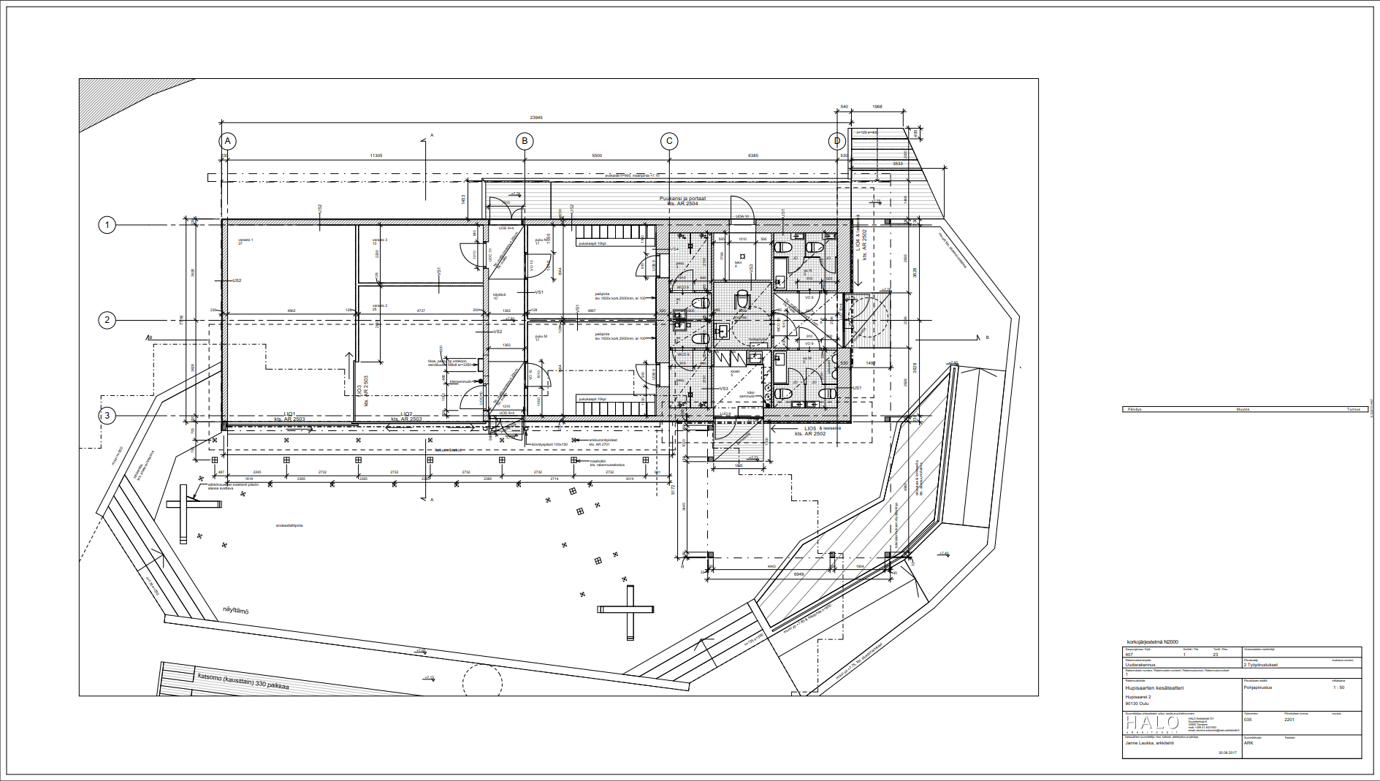
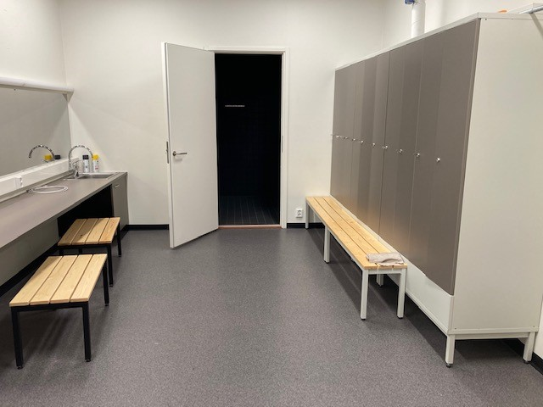
Theatre floor plan
dressing room
public WCs
Dressing rooms
set storage
dressing room
Kiosk

Slide 17
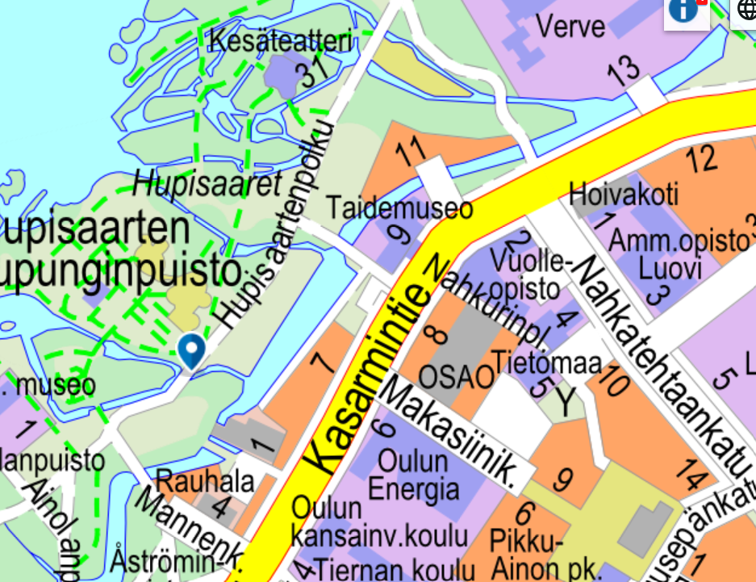
Parking and Service Routes
The theatre does not have its own parking spaces. At the city end of the Oulu Art Museum, there is a small public parking area (with a parking disc) that also includes two accessible parking spaces.
Only service vehicles are allowed on the theatre grounds. The recommended route for vehicles is via the bridge next to the art museum (the route is marked with arrows).
Vehicles may not be parked or stored on the theatre grounds or on the adjacent park area. Temporary stopping of a vehicle on the grounds is allowed only during service operations.
Parking must be done only in designated and authorised parking areas.

Slide 18
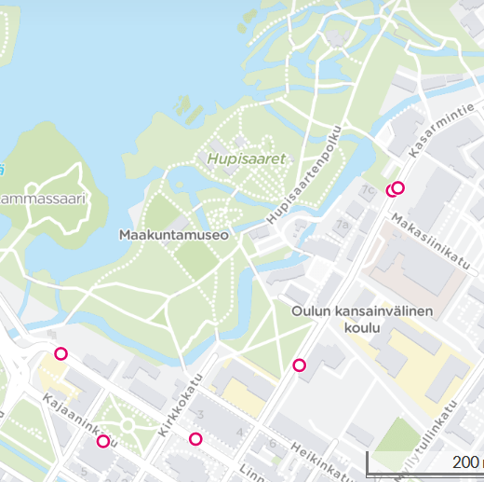
Public Transport and Access
Audience members are encouraged to arrive at the theatre on foot, by bicycle, or using public transport.
The nearest bus stops within walking distance are on Kasarmintie:
  Nahkatehtaankatu P and E
  Makasiininkatu P and E
Additional stops near the Cathedral: Franzen and Kuvernööri.
The nearest paid parking areas are the Hotelli Lasaret parking lot and Autoheikki.

Slide 19
Subcontracting Services
Below are a few examples of companies and associations that provide services. More service providers can be found in the Event Organiser’s Guide:
https://www.ouka.fi/en/guide-event-organizers
Security:
  Oulun alueen järjestyksenvalvojat ry https://oajv.wordpress.com/
  Securitas Oy https://www.securitas.fi/
  SeSP Oy https://sesp.fi/
Café and Beverage Service:
  Kahvila Kiikku / Rina Hirviniemi +358 45 132 8806 / kahvilakiikku@gmail.com
Technical services:
  Oulun Kongressitekniikka Oy / Jouko Kettunen puh. +358 40 5532473 / jouko.kettunen@oktoy.fi

Slide 20
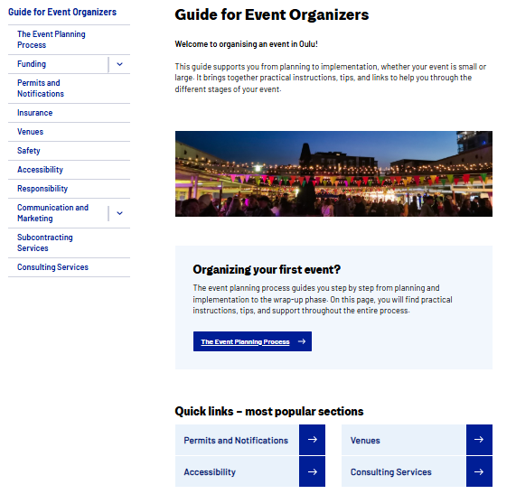
Event Organiser’s Guide
Information and guidelines for organising events:
https://www.ouka.fi/en/guide-event-organizers

Slide 21
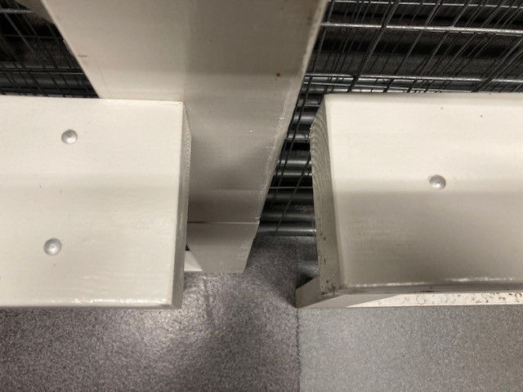
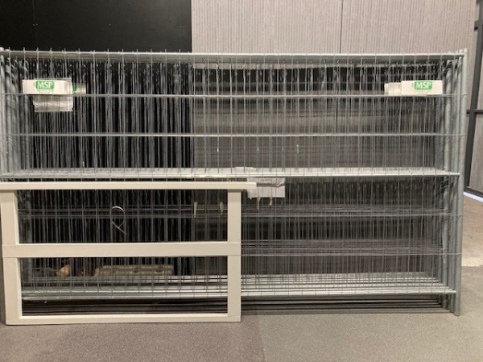
Area Fencing
The theatre has two types of fences. The smaller white fences are designed to block the bridges that cross the theatre area.
Since the bridges are of different sizes, the fences also vary in size. The number of screws (1–4) marked on one end of each fence indicates which bridge it fits.

