Slide 1
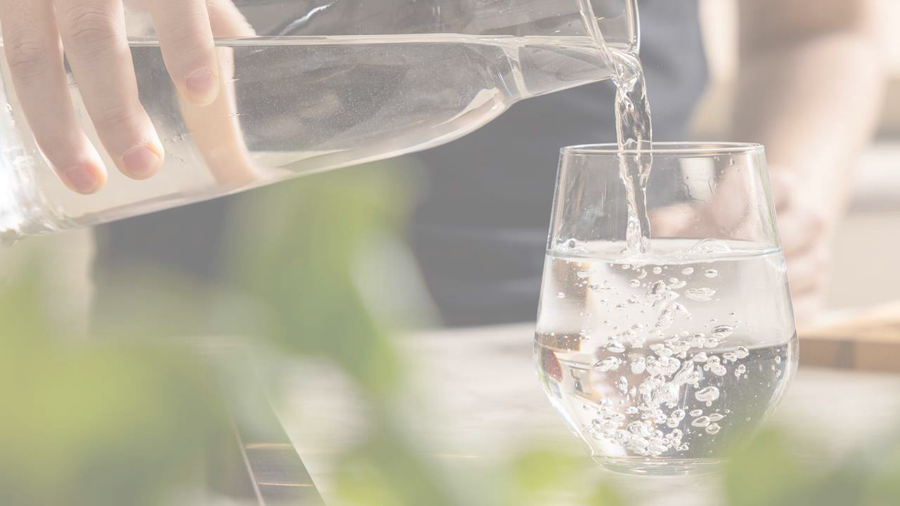
1
AboutWater
8.9.2023

Slide 2
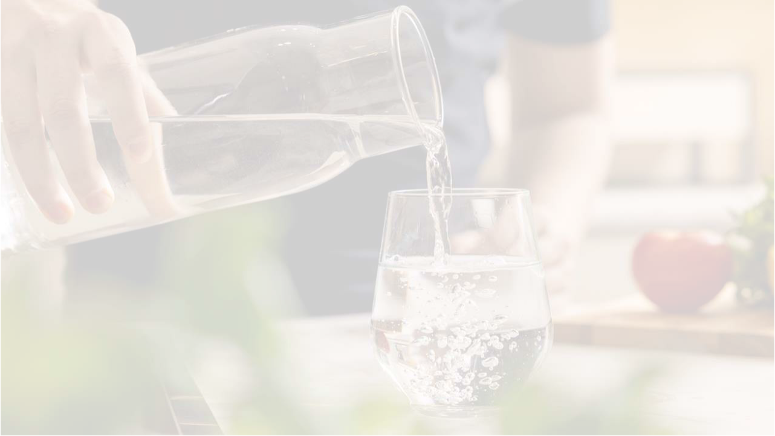
CleanWateris Vital
•Bothhumansand animalscannotlive without
water.
•Cleantapwateris a rareprivilege: potabletap
wateris foundonlyin 28 countriesin the
world
•Tapwateris healthyand safeeverywherein
Finland.
8.9.2023 ²

Slide 3
CleanWateris Vital
•Accordingto UNICEF,everyoneneedsaccessto at
least15-20 litersof cleanwatera dayto surviveand
stayhealthy.
•In Oulu,about130 litersof wateris useda dayper
person.
•Dirtywatercausesa rangeof illnessesin
countrieswherewatersupplyis defective.
•Thecleanlinessof tapwateris beingmonitored
dailybytakingsamplesin Finland.
8.9.2023 ³

Slide 4
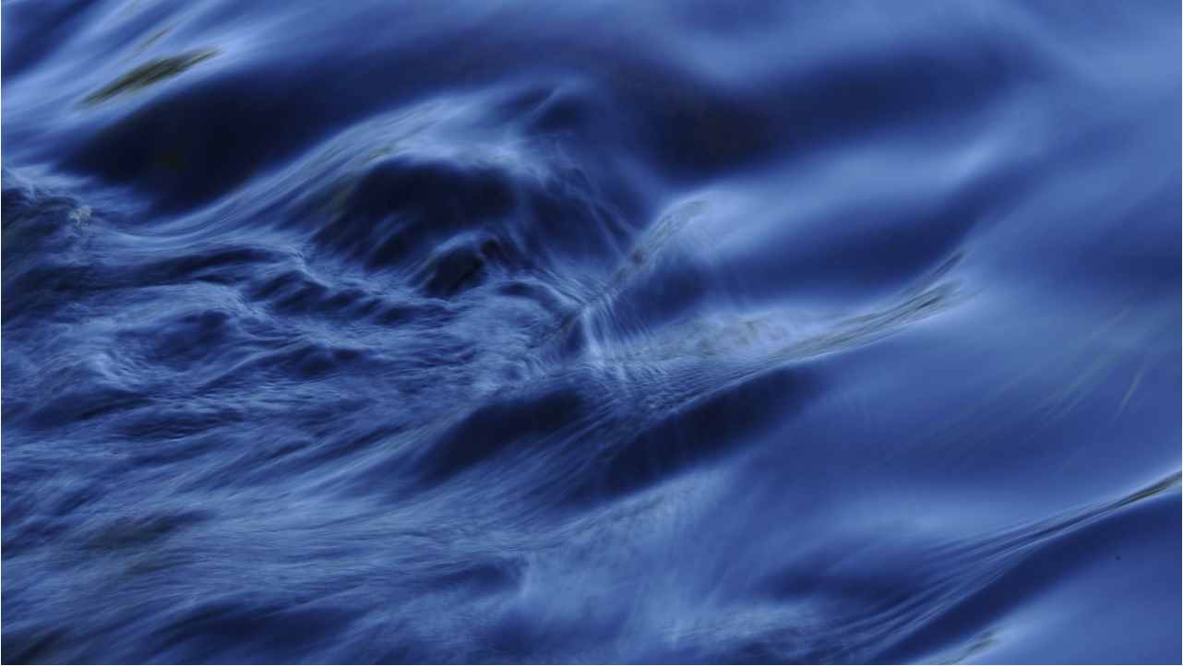
Wheredoestapwatercomefrom?
•Watercanbepreparedfor humansfromrivers, lakes,
orfromgroundwater, whichis foundunderground. In
Oulu,watercomesfromtheOulujoki orfrom
groundwater.
•River wateris purifiedin twowatertreatmentplants.
•Therea multipletreatmentplantsfor groundwaterin the
Oulu region.
•Wateris purifiedaroundtheclock, and everydayenough
wateris preparedthatit couldfillsevenswimmingpools.
8.9.2023 ⁴

Slide 5
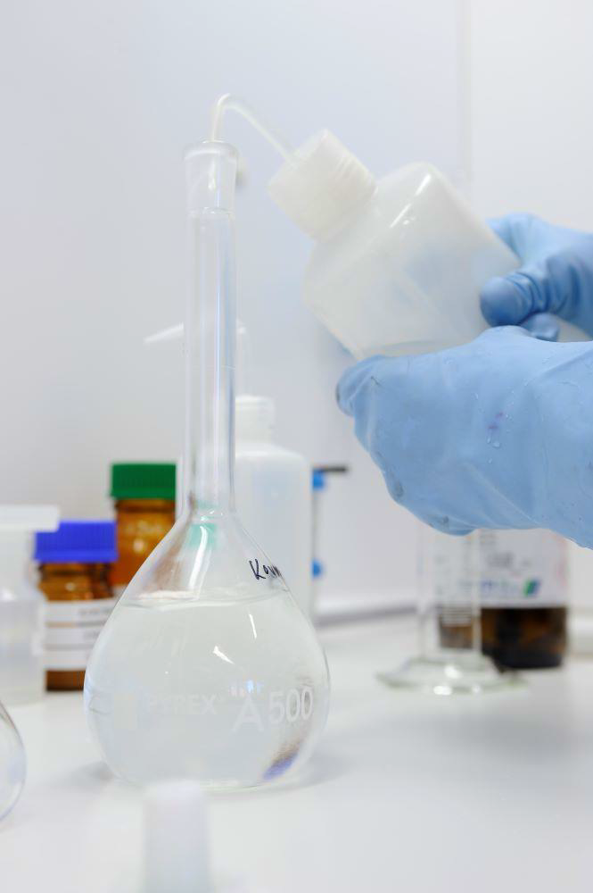
WaterPreparationRequiresPrecision
• Waterpurificationis a multi-stageprocess.
• It takesaroundfivehoursfor waterto travel
throughthewaterplant.
• Tap water preparation purifies untreated water
from all harmful substances and microbes, so
that the water isn't dangerous tohuman health.
• Dirty substances and harmful microbes end up
in surface waters from the environment due
torains, drainage, air, and human activity. So,
surface water always requires thorough
treatment.
• Groundwateroftenrequiressome treatment
also. In Oulu, groundwatersaretreatedby
alkalifyingand UV disinfectionwhenneeded.
Whennecessaryironand magnanesearealso
removedfromthewaters.
8.9.2023 ⁵

Slide 6
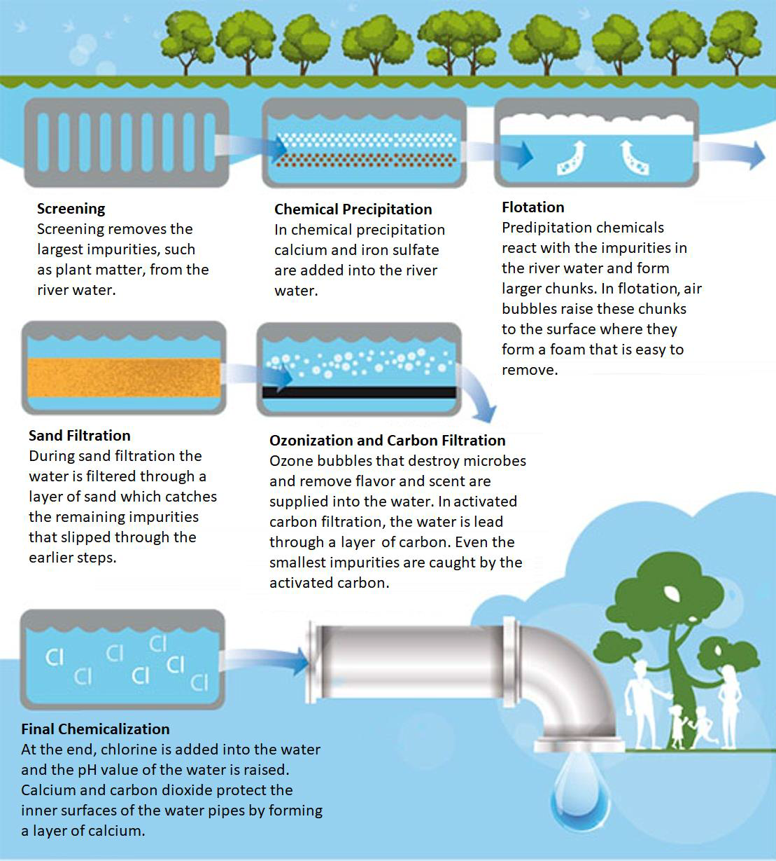
Domestic Water
Purification
Treatment
8.9.2023 ⁶

Slide 7
WaterFlowsUndertheGround
•Therearepipesunderground carryingcleanwateras
wellas sewagewater.
•Oulu has
•1980 kilometersof waterpipes
•1330 kilometersof sewagepipes
•680 kilometersof rainwaterpipes
•Thepipesvaryin sizes, up to 160 cm in diameter.
•If westraightenedallthepipes, theywouldreachall
thewayto Latvia.
8.9.2023 ⁷

Slide 8
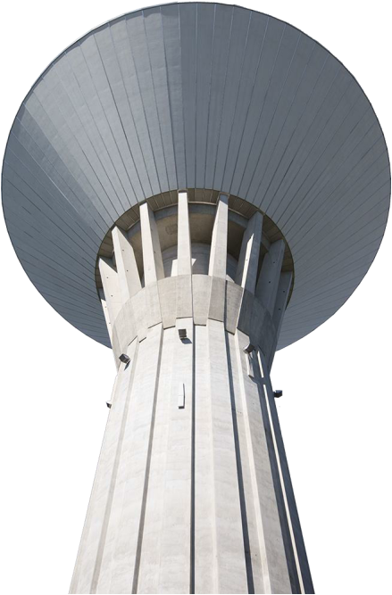
WaterTowers
•Watertowersstorecleanwater.
•Thetowersfillupeachnight, and during
thedaythewateris directedinto the
waterpipes.
•Therearefiveactivewatertowersin
Oulu: Puolivälinkangas, Maikkula,
Kiiminki, Oulunsalo, and Haukipudas.
8.9.2023 ⁸

Slide 9
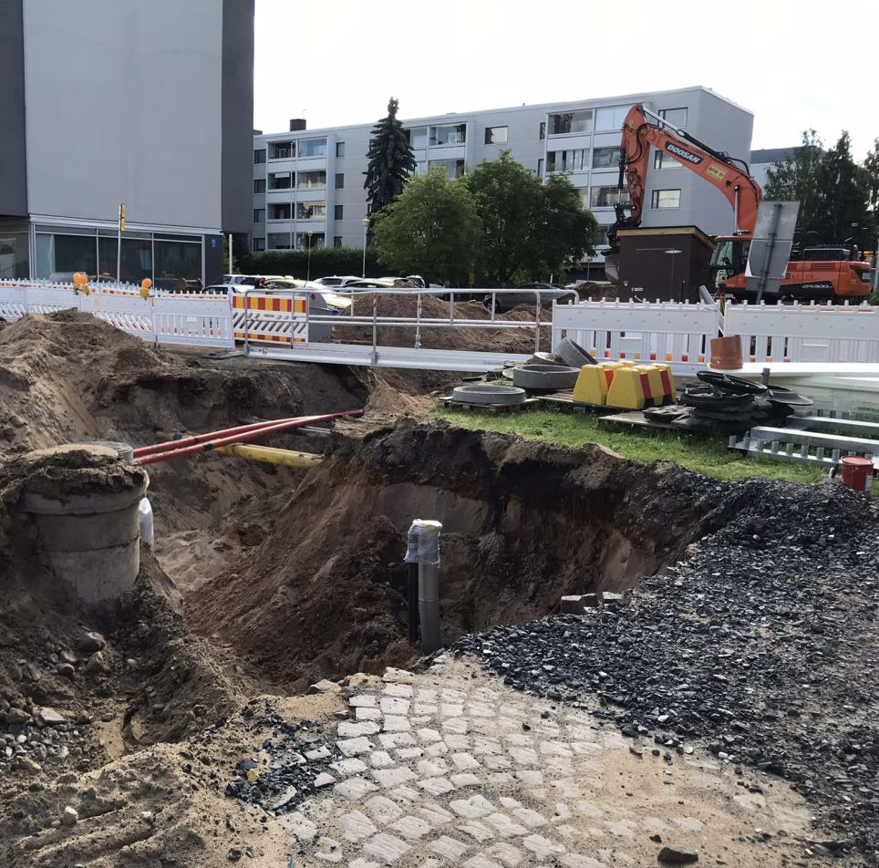
Networks areConstructedand Repaired
•Oulu hasa largesurface
areaand it hasa lotof pipe
networks.
•EachyearOulu Waterworks
constructsorrenovatesa
totalof 40 km of newand
oldnetworks.
•Theretheamountof
renovationneedsto
increasein orderto secure
waterqualityand avoid
malfunctions.
8.9.2023 ⁹

Slide 10
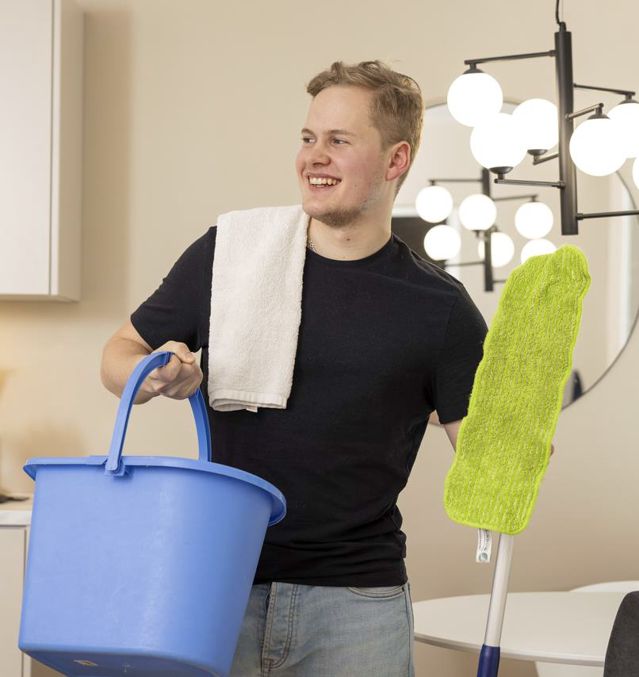
Substancesdon'tDisappearin theSewers
• Harmfulsubstancesin thesewers
mightdisturbsewagepurification.
• Donotputoils, heavy metals, paints,
medicineetc. into toiletbowlsorwash
basins.
• Oils, lastingorganiccompounds, and
heavy metalsareharmfulto purification
treatmentand tothemarine
environment.
• Microplasticsendupbeingeatenby
fish. Otherharmfulsubstancesfromthe
environmentalsostickto plastics.
• Heavy metalsendupin sludgeand
maydisturbitsfurtheruseas fertilizer.
8.9.2023 ¹⁰

Slide 11
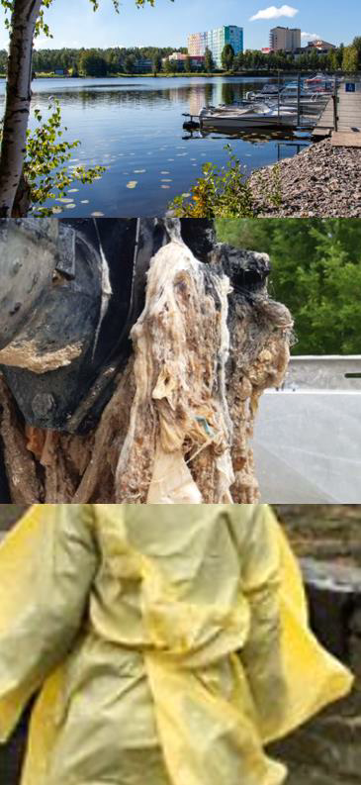
RecentEventsareVisiblein theSewers
• Disposablefacemasksand gloves
flusheddowntoiletscauseblockages
in sewers. Around400cubicmetersof
sewagewasreleasedinto lake Saimaa.
Swimmingwasbannedin thelake.
• Disposablefacemasksand
disinfectantwipesare
throwncarelesslyinto sewers. Clearing
blockedsewerscosts300 € eachtime.
• Festival customersprotected
themselvesfromtherainin Oulu. After
theweekend, disposableraincoats
appearedin sewersand
watertreatmentplants.
8.9.2023 ¹¹

Slide 12
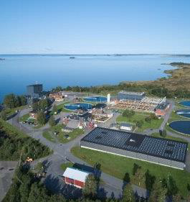
SewageWaterPurificationis Important
• If we didn't purify sewage, a notable
amount of solid matter and nutrients
would end up in the sea. Harmful and
dangerous substances would destroy
marine environment and would also
cause health dangers to humans.
• Solidmatterwouldcausenutrient
loading, muddythewaters, and
consumeoxygenfromthewater. Excess
nutrientseutrophicatemarineareas.
• Mostof theharmfulsubstancesthat
endupin sewageoriginatefrom
ordinaryhomes.
8.9.2023 ¹²

Slide 13
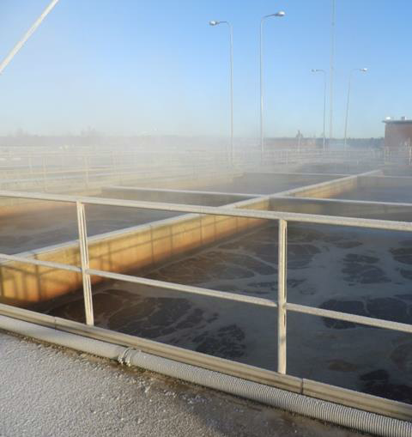
Sewage from Oulainen is purified in the
water treatment plant in Taskila
•Sewage purification is a
multi-stage process.
•At the treatment plant
sludge and sewage is
separated from the water.
•Purified water is released
into the sea, and it does
not harm wildlife.
8.9.2023 ¹³

Slide 14
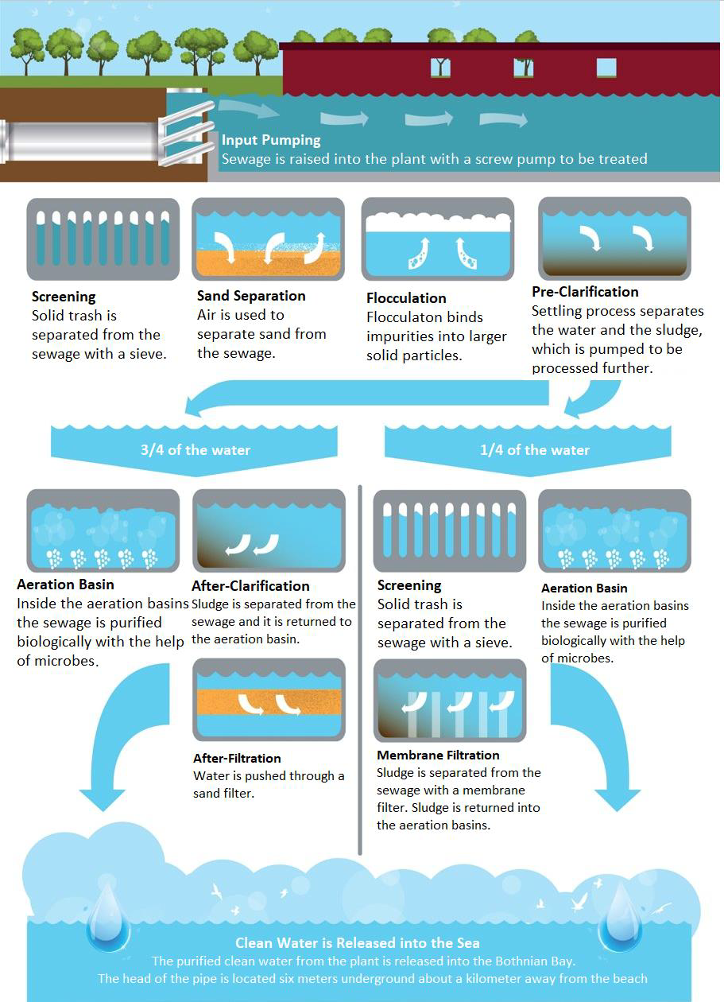
Sewage
Purification
Treatment
8.9.2023 ¹⁴

Slide 15
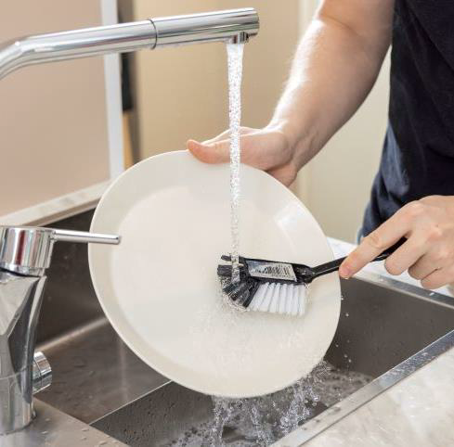
SaveWaterEveryday
•Weusewatereverydayfor
washing, cooking, drinking,
doingthedishes, and
usingthetoilet.
•Waterpreparationand
sewagetreatmentrequires
chemicalsand energy.
•Whenyousavewateryou
alsosaveenergy!
8.9.2023 ¹⁵

Slide 16
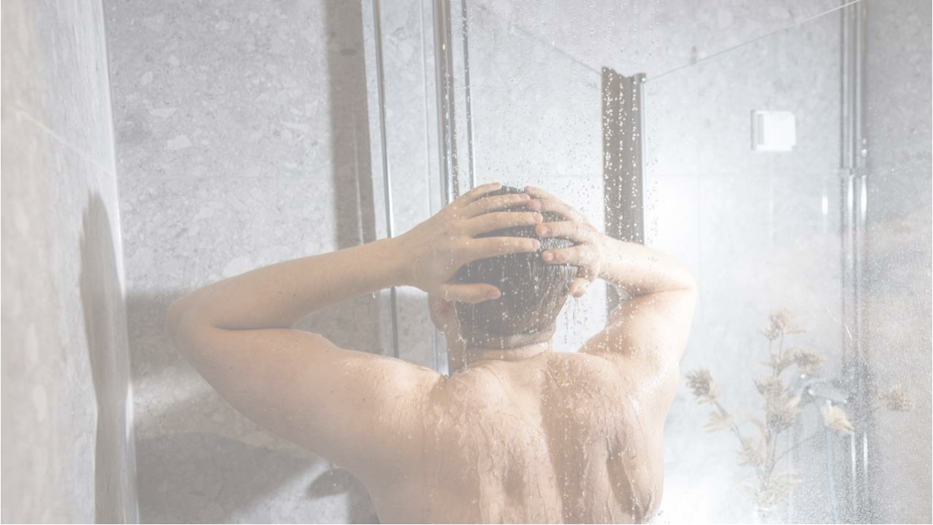
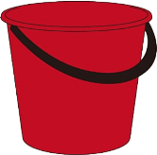
ShoweronlywhenNeeded
1 minutein theshower= 12 litersof water
5 minutesin theshower= 60 litersof water
15 minutesin theshower= 180 litersof water
8.9.2023 ¹⁶

Slide 17
WaterFootprint
•Water footprint illustrates the importance of water in
our lives.
•A water footprint consists of all our water use: water
straight from the tap as well as so-called virtual
water.
•Youcancalculateyourownwaterfootprint
convenientlywiththe Water Footprint Calculator
made bytheFinnishEnvironment Institute. (In
Finnish)
8.9.2023 ¹⁷

Slide 18
WaterFootprintsof some Products
https://waterfootprint.org/en/resources/interactive-tools/product-gallery/
• Milk, 1020 l/kg
• Cotton, 10 000 l/kg
• Coffee, 18 900 l/kg. ~130 lper cup
• Tea, 8 900 l/kg
• Chocolate, 17 200 l/kg
• Beef, 15 500 l/kg
• Banana, 790 l/kg
• Apple, 822 l/kg
• Potato, 290 l/kg
8.9.2023 ¹⁸

Slide 19
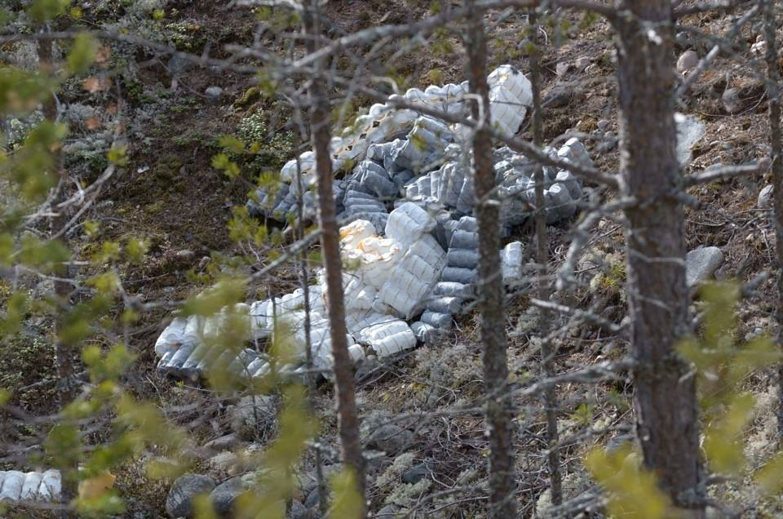
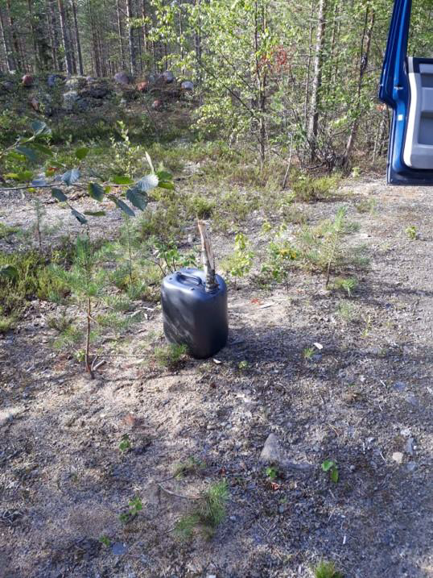
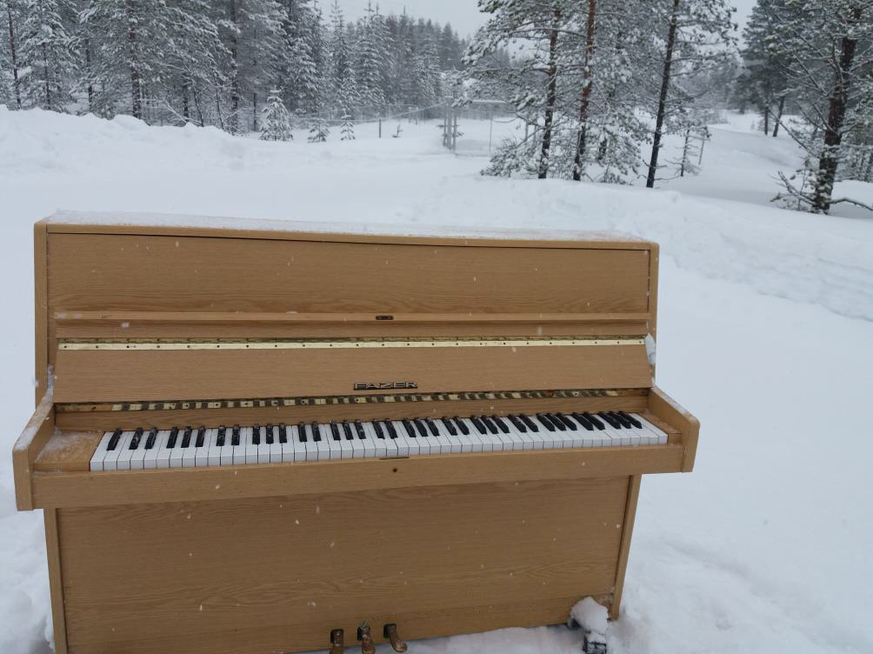
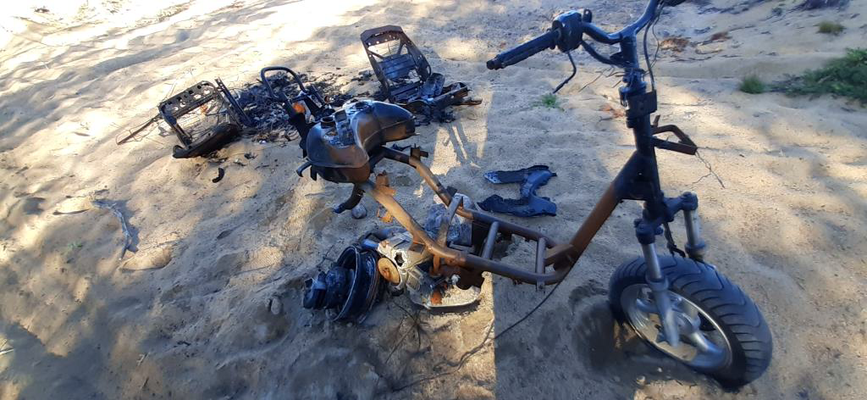
Be Observant around
Groundwater areas!
• One importantresponsibilityaround
groundwaterareasis observation.
• At worst, trashand garbagethrown
into naturecouldevencontaminate
groundwaters.

Slide 20
WhatcanI do?
•Usewatersparingly
•Takecareof nature: don'tthrowtrashinto watersor
sewers
•Don'tflushanythingdownthetoiletthatdoesn't
belongin thewaterways
•Admireourbeautifulriversand lakes, and enjoy
cleanFinnishtapwaterwitha smileon yourface☺
8.9.2023 ²⁰

Slide 21
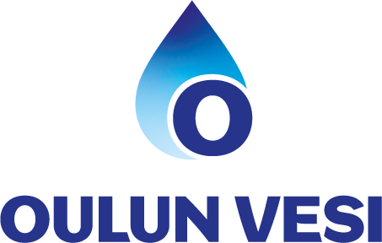
Thankyoufor
yourinterest
www.oulunvesi.fi

