Slide 1


Slide 2
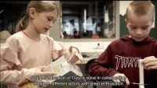
WHAT IS STEAM IN PRACTICE?

Slide 3
STEAM in Oulu
CONTENT
1. The ABCs of STEAM in Oulu
2. Growing into a regional development network
3. On the path to learning
4. STEAM events and innovation projects

Slide 4
1. The ABC of STEAM in Oulu

Slide 5

STEAM in Oulu
Which Innovative community in Oulu
What Promoting creativity and curiosity
Why Looking for solutions to the challenges of the future
Where At the intersection of arts, media, science, and technology
How Joining fields of learning and subjects into larger wholes
Who Teaching and early childhood education professionals in collaboration with children and youth

Slide 6
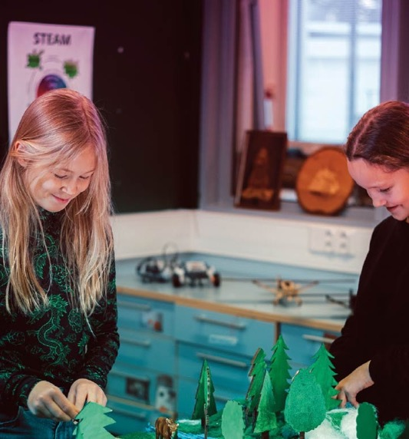
”STEAM can be employed to teach more integrated learning entities made up a composite of various subjects. Teaching such planned-out entities rather than individual disconnected lessons is much more rewarding for pupils and teachers alike.”
  Sanna Mäkelä, Ylikiimingin koulu
  (Comprehensive school)

Slide 7


STEAM
Letter by letter
Science
Technology
Engineering
Arts
Mathematics
In Finnish - Swedish
Tiede - Vetenskap
Teknologia - Teknologi
Insinööritaidot - Ingenjörskonster
Taide - Konst
Matematiikka - Matematik

Slide 8

The fundamental principle:
Doing more together
working together
a communal, experimental way of learning
”STEAM means that both the teacher and the pupil are encouraged and strengthened by doing things themselves. Those are inspiring experiences.”
  Jaakko Määttä, Oulujoen alakoulu (elementary school)

Slide 9

Vision 2026
Boldly on the edge – STEAM in Oulu. Towards a creative method through doing together.
  Boldly on the edge – innovative, daring to try and to fail
  A creative culture – experimental and constantly developing
Values
  Doing more together
  Be inspired and to inspire others
  Learner-centered approach
  Open to everybody
  Boldly experimenting

Slide 10

Focus areas
  Meaningful co-creation
  Permission to experiment and fail
  Emphasis on art and the design process
  Learner-centered approach
  Culture of sharing and collaboration
  Strong connection to pedagogy and daily life
  Active mentoring
  The role and commitment of management

Slide 11
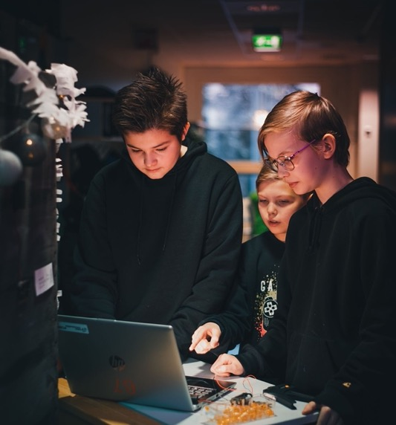
“STEAM has been a turning point and changing the entire culture of our school.”
  Pekka Pöyhtäri, Hintan alakoulu (elementary school)

Slide 12
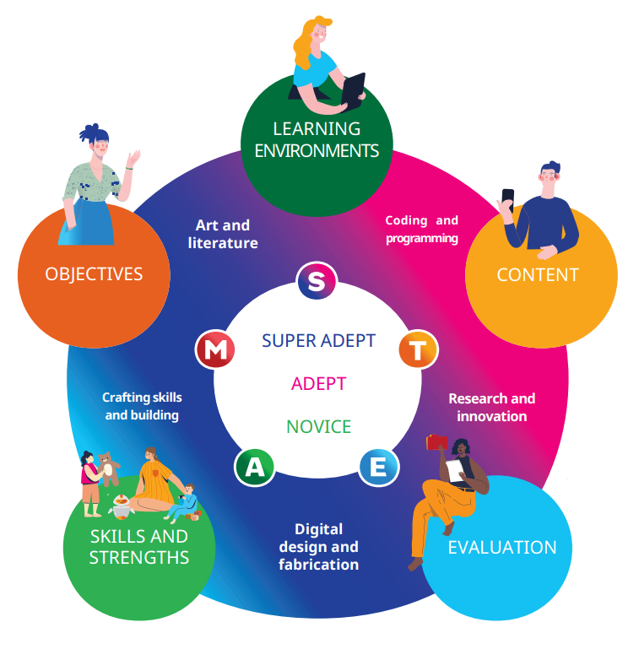
Elements

Slide 13
2. Growing towards a regional development network

Slide 14

Growing towards a regional development network
At the core is the education program of the City of Oulu: Education builds Oulu
Strong support from the city leadership
An integral part of the Oulu city strategy
A significant factor in the Oulu2026 European Capital of Culture project
A way to ensure an adequate and capable workforce for the future
A part of the FabCity Network 2023=>
“Oulu nurtures well-being, caring, and active citizens together within strong education and competence networks.”
  City Strategy

Slide 15
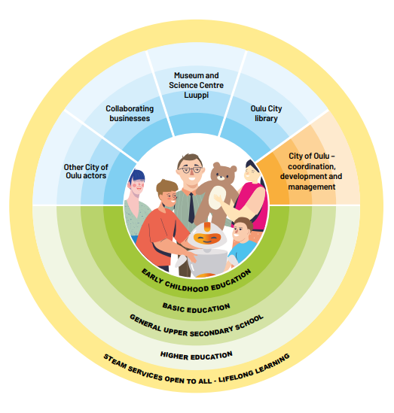
Enabled by

Slide 16

Collaboration with the University of Oulu
Educational sciences
Minor in STEAM teaching
Supplementary training
Research and development
Teacher internships in STEAM units
Students participating in projects in STEAM units
Developing STEAM activities in lower secondary schools
Natural sciences
LUMA Centre
Science Education Working Group
Information technology and electronics
FabLab

Slide 17
Joint development with businesses
MeKiwi
Lekolar
Holomonsters
Playsign
Happia

Slide 18
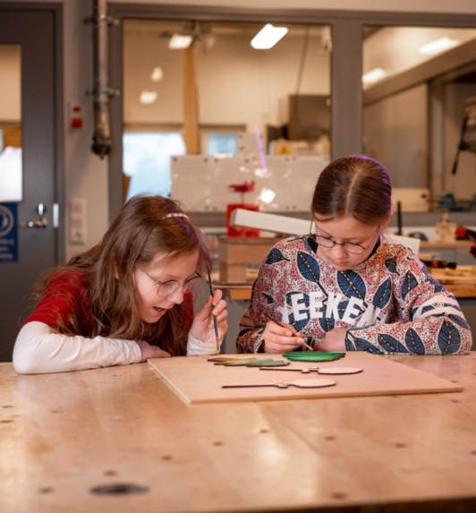
International cooperation
  information exchange
  expert exchange
  joint seminars
  university and educational cooperation
  In addition, STEAM Residency projects involving collaboration among teachers, students, and artists.

Slide 19
3. On the path to learning

Slide 20
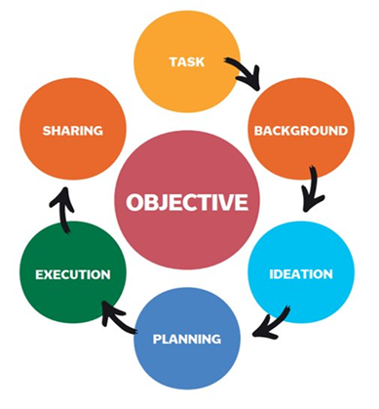
The STEAM process
  Repeated in every STEAM implementation
  Applicable for various theme from product design all the way to knowledge-based education

Slide 21
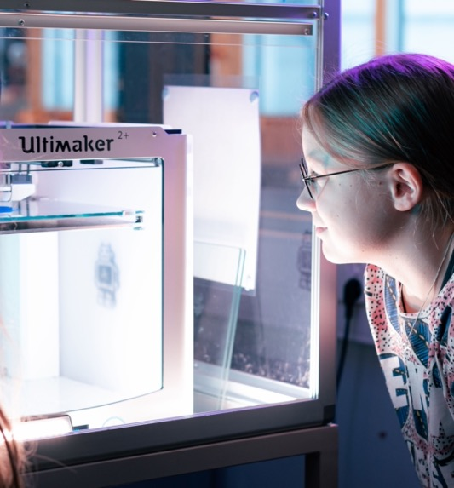
The processes emphasize
  Joint development
  Exploring and understanding the theme
  Combining creative and rational thinking
  Concretization of ideas
  Failure – learning at its best

Slide 22
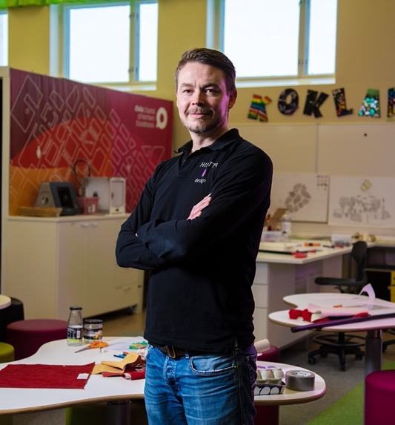
”In STEAM, comprehensive concepts are addressed, and learning occurs by combining different elements. When the work is enjoyable and brings joy, learning happens almost effortlessly.”
Pekka Pöyhtäri, Hintán alakoulu (elementary school)

Slide 23

Tips for the STEAM process
Take into account the participants' skills and diversity.
Tolerating uncertainty is part of the process.
Progress happens at the learners' pace.
STEAM brings freedom – make use of it
Make things tangible to the learners

Slide 24

Learning entities
Novice
  A good place to start
  Tasks suitable for everybody
Expert
  Able to combine STEAM sub-disciplines and subject knowledge
  Tasks suitable for more advanced learners
Master
  Can choose the most appropriate approach
  Utilizes technology appropriately.
  Gathers information and combines knowledge from different subjects with each other

Slide 25
4. STEAM events and innovation projects

Slide 26
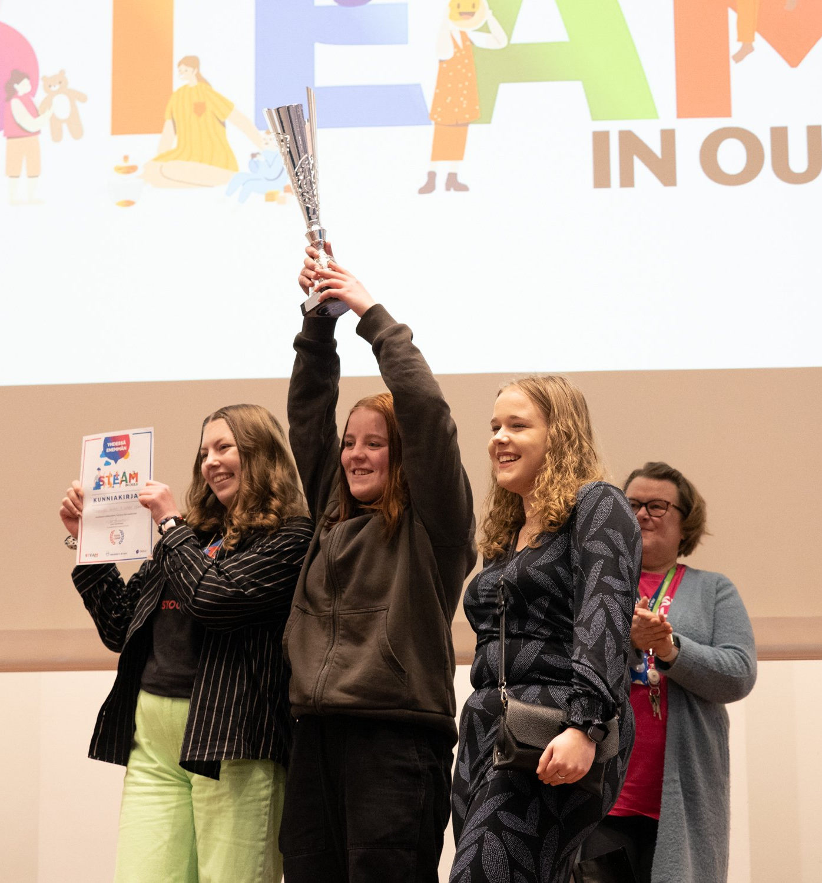
ToolCamp
Innovation challenge and event
  Time: May 2024
  Place: University of Oulu
  Planning team lead: Educational and Cultural Services at the City of Oulu
  The challenges are released at the end of the previous academic year, and the work can be planned according to the school's/class's preferences for the upcoming year.
  Students present the solutions to the challenges at the ToolCamp event.
  There are several award categories.
  Stakeholders have the opportunity to showcase their products and organize workshops during the event.

Slide 27
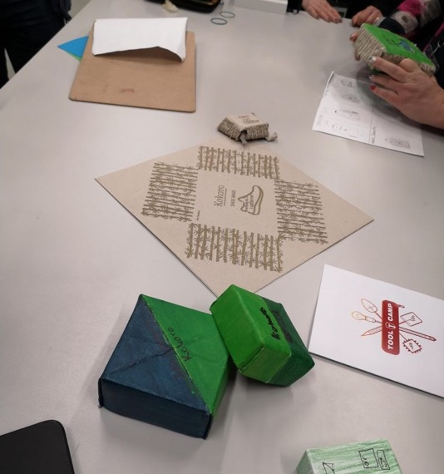
Amazing North
collaboration event
  Time: In May every second year (2-day event)
  Place: varies
  Planning team lead: Educational and Cultural Services of the City of Oulu
  Goal:
  Increasing awareness of the STEAM in Oulu network
  Each actor can present their activities from their own point of view
  Stakeholders may present their products and organize workshops

