Slide 1
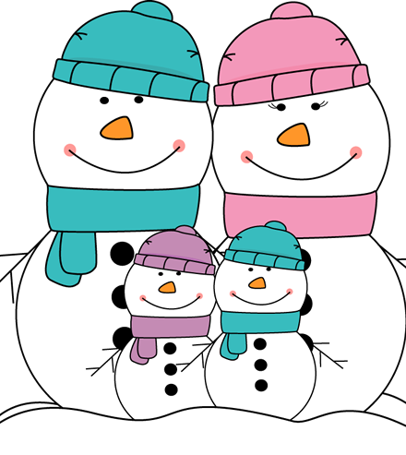
Snowmen, snowmen
Standing in a row.
When the sun comes out
then where will you go?

Slide 2
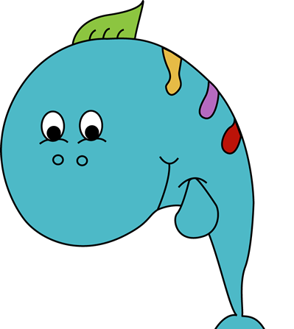
I'm a little fish
Splish splash splish.
I don't want to end up
On your supper dish.

