Slide 1
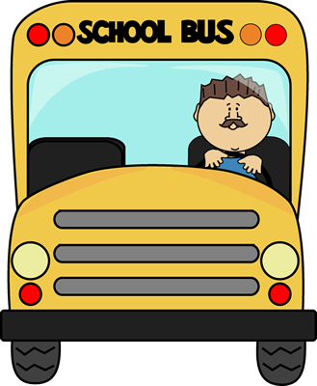
Riding on a bus. (Beep!)
Sitting on a train. (Whoosh!)
Sailing in a ship.
Flying in a plane.

