Slide 1


Crack some eggs,
crack some eggs
crack some eggs
for tea.
Put them in a frying pan and feed them all
to me.

Slide 2
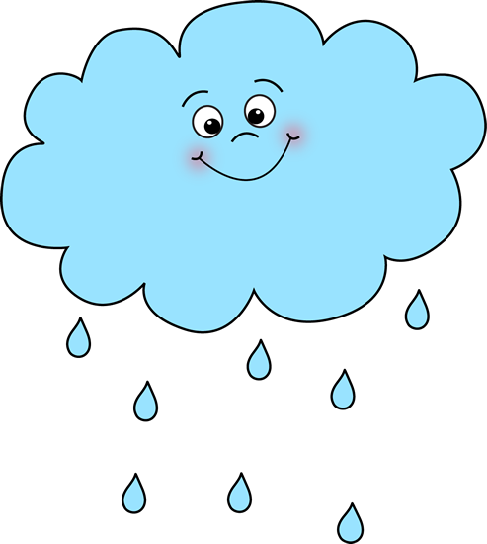
Rain, rain, go away.
Come again
some other day.

